Slide 1
Model-based analyses for DLT outcomes
Kristian Brock

Slide 2
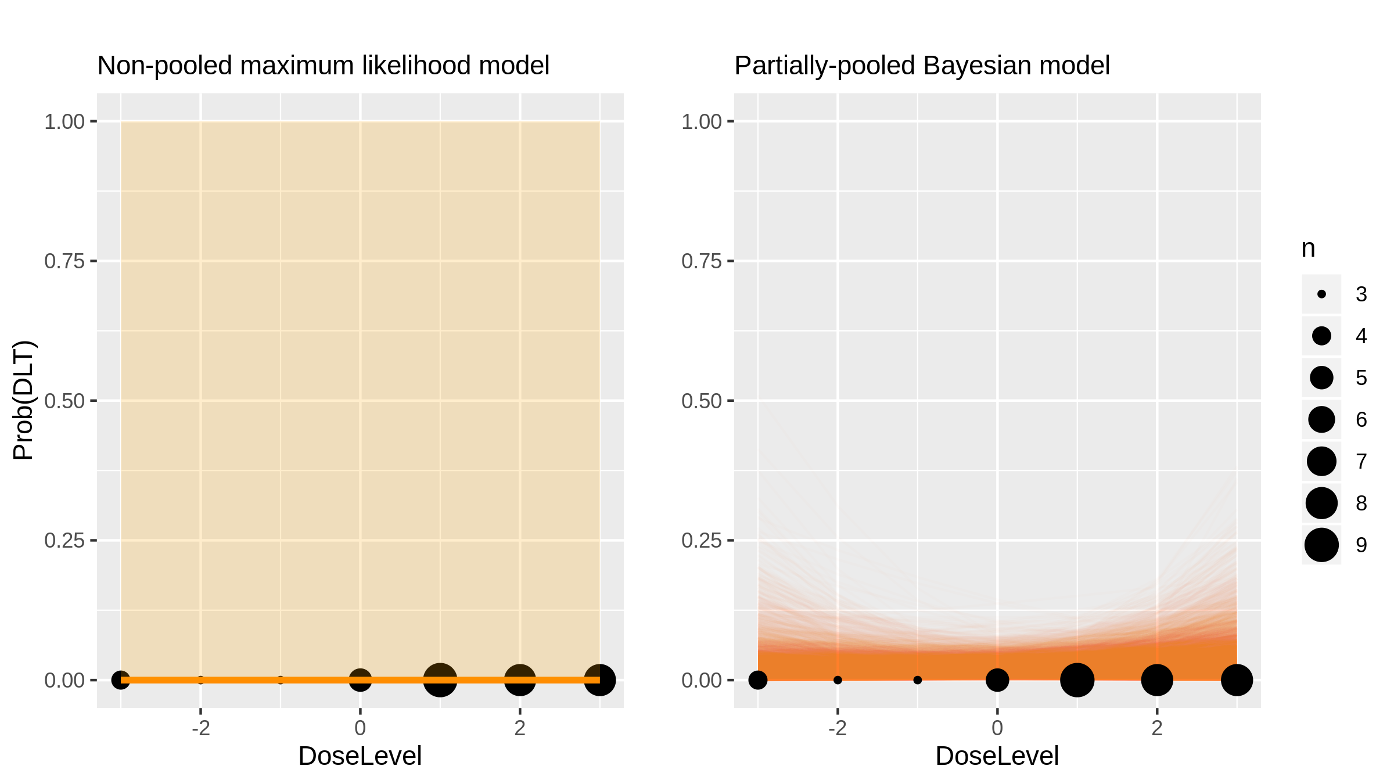
LBY135 (Monoclonal Antibody) in Advanced Solid Tumours [Sharma2014_1]

Slide 3
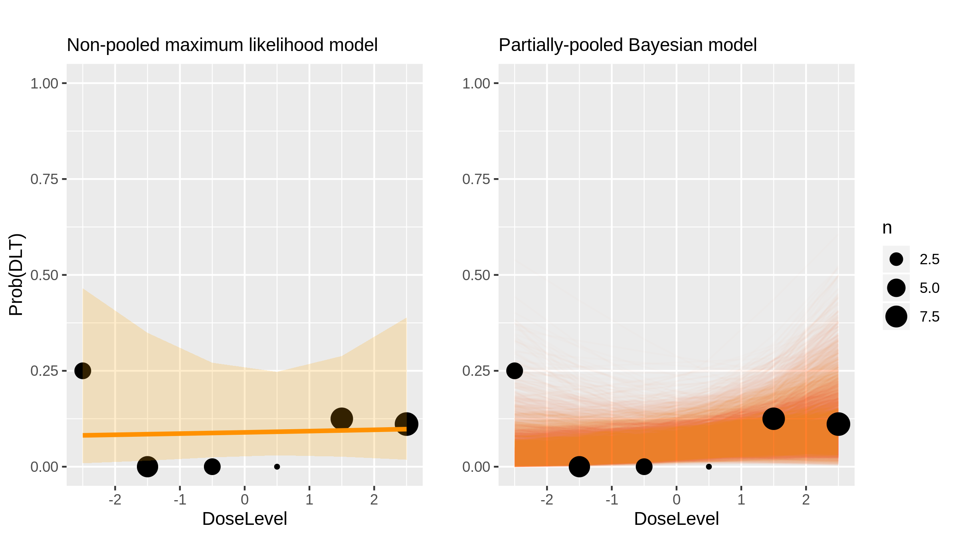
LBY135 (Monoclonal Antibody) in Advanced Solid Tumours [Sharma2014_2]

Slide 4
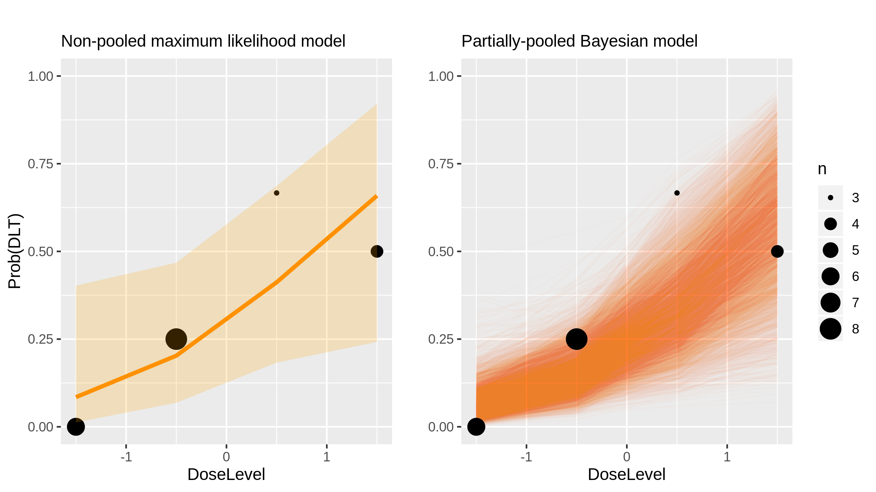
Gemcitabine (Chemotherapy) in Head And Neck Cancer [Popovtzer2014_1]

Slide 5
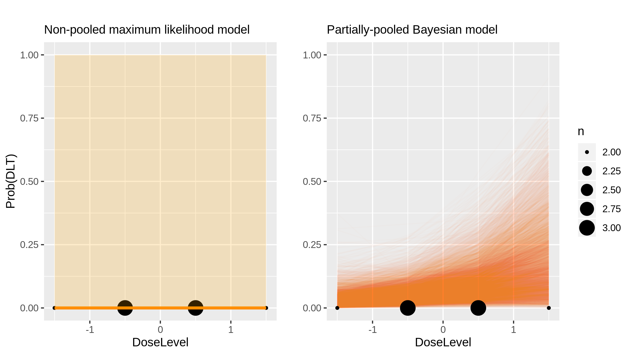
Bendamustine (Chemotherapy) in Cll [Khouri2014_1]

Slide 6
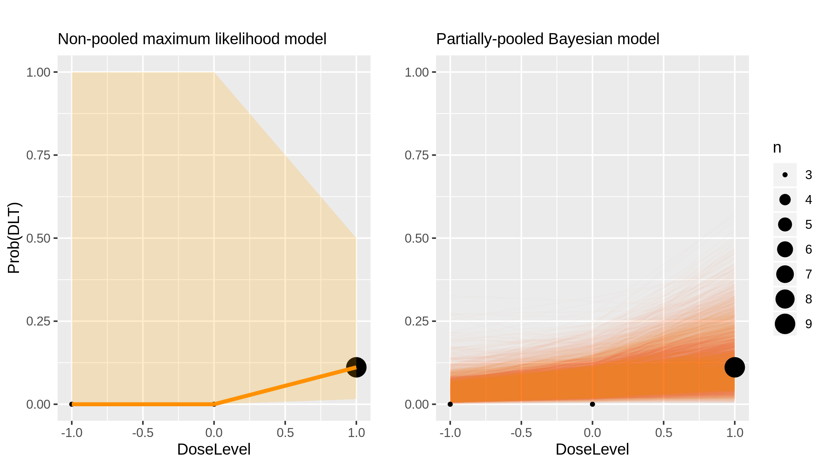
Buparlisib (Inhibitor) in Advanced Solid Tumours [Ando2014_1]

Slide 7
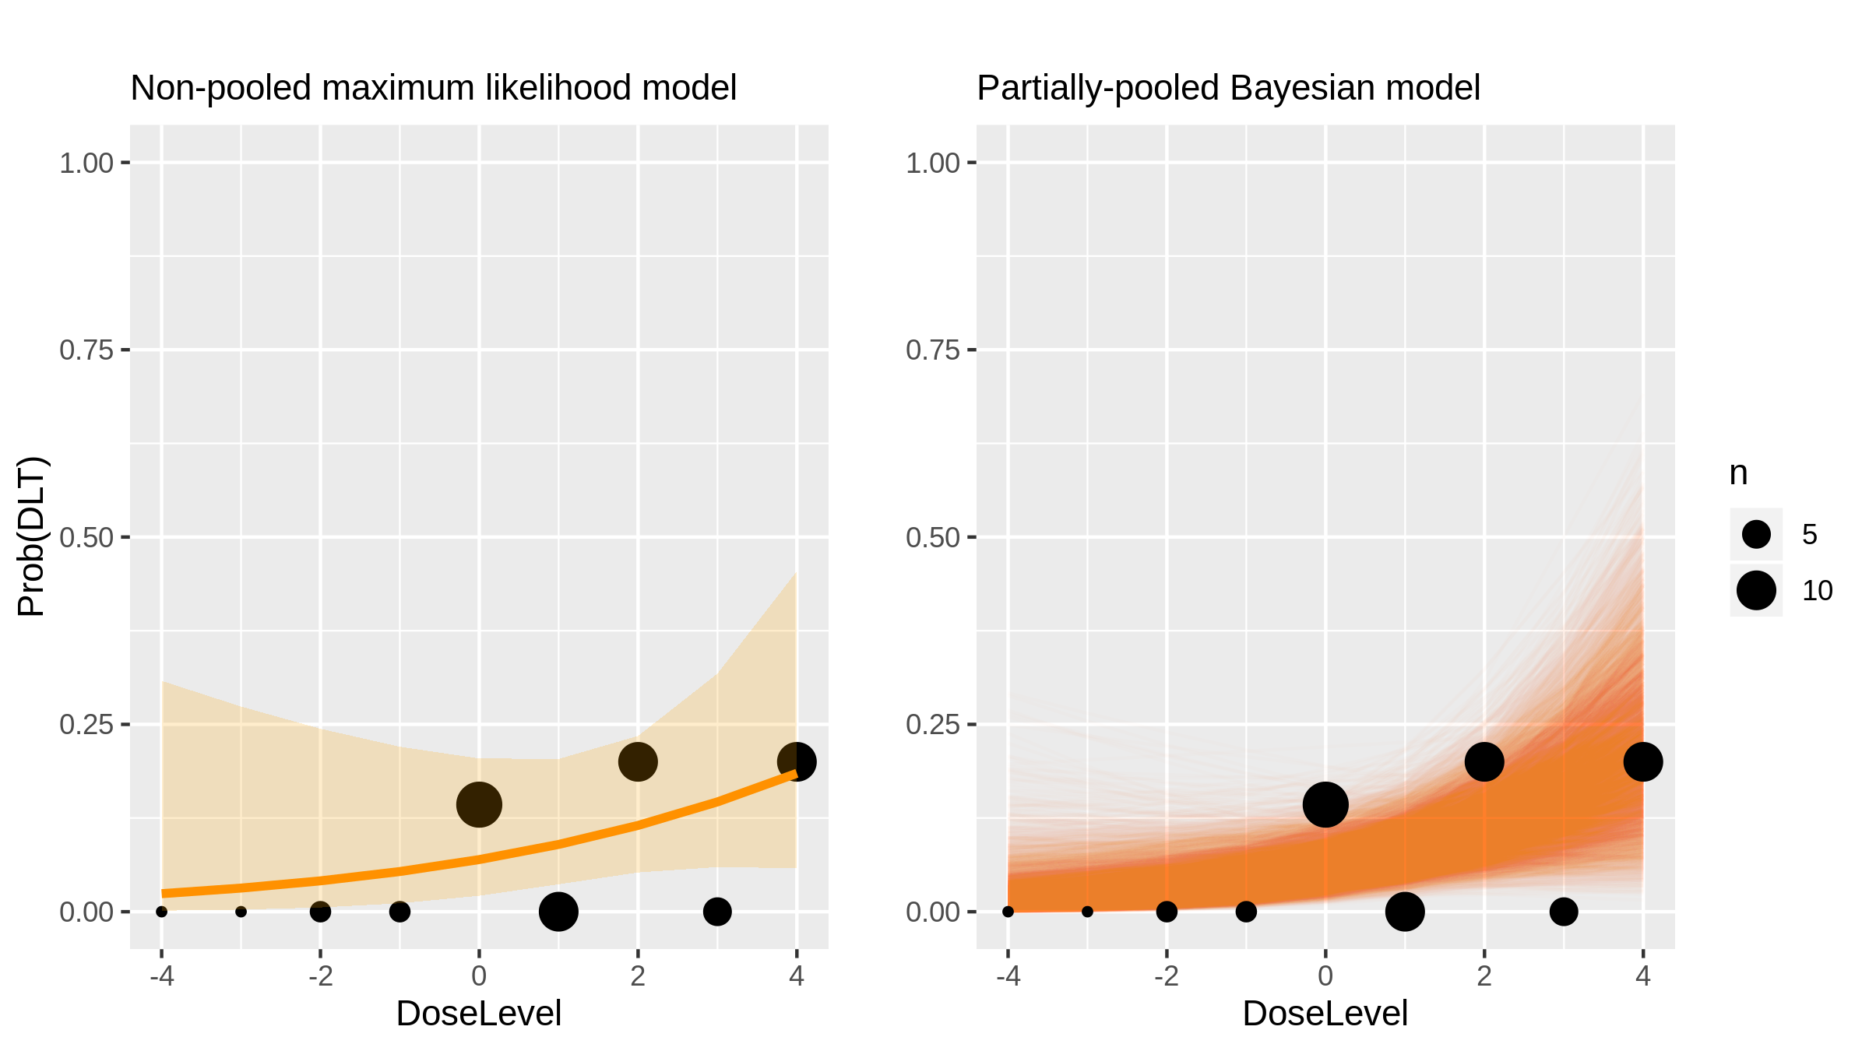
Ceritinib (Inhibitor) in Nsclc [Shaw2014_1]

Slide 8
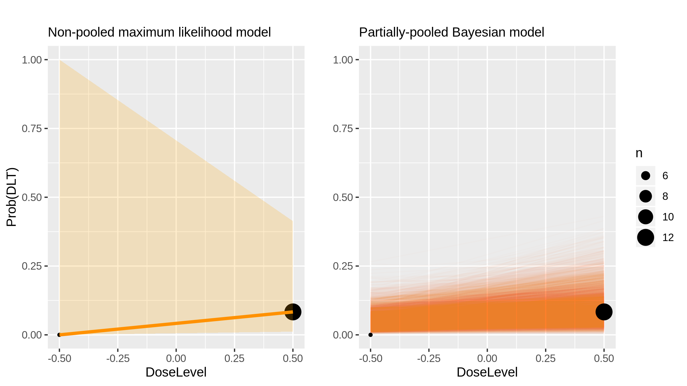
Buparlisib (Inhibitor) in Breast Cancer [Saura2014_1]

Slide 9
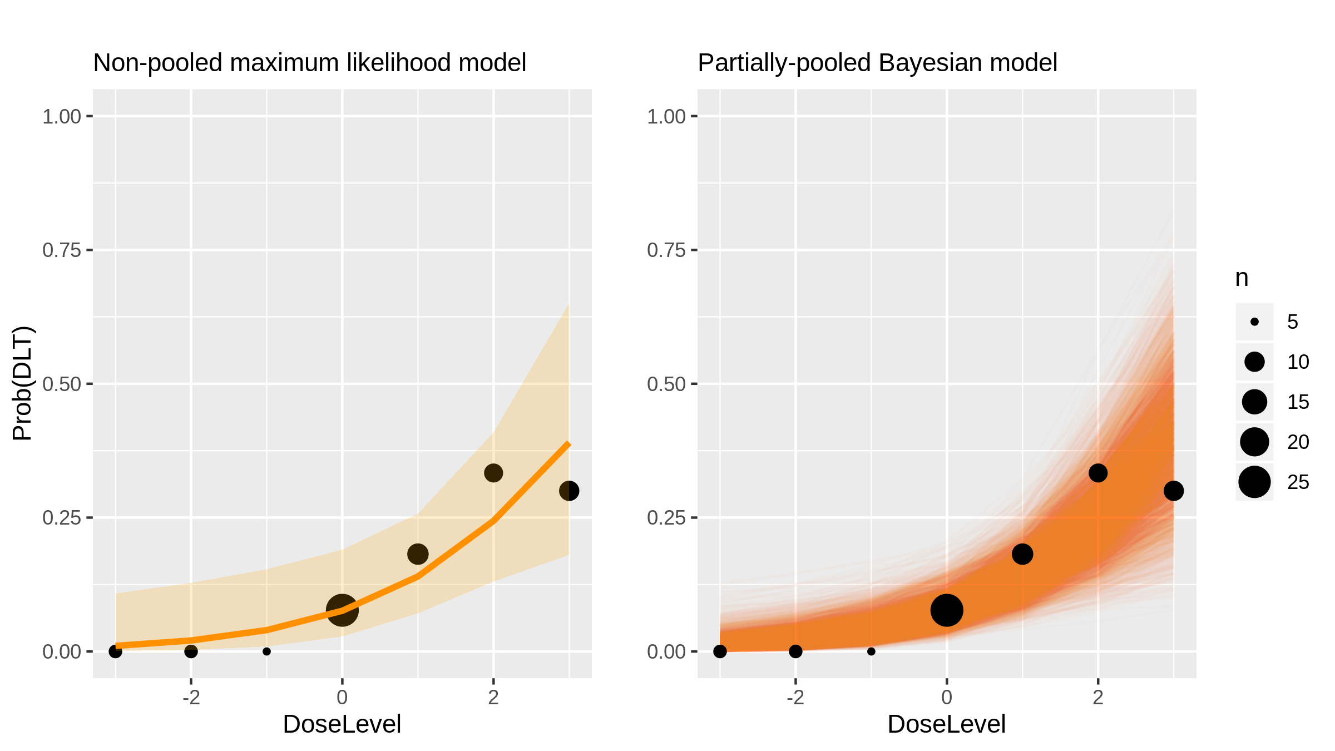
Sonidegib (Inhibitor) in Advanced Solid Tumours [Rodon2014a_1]

Slide 10
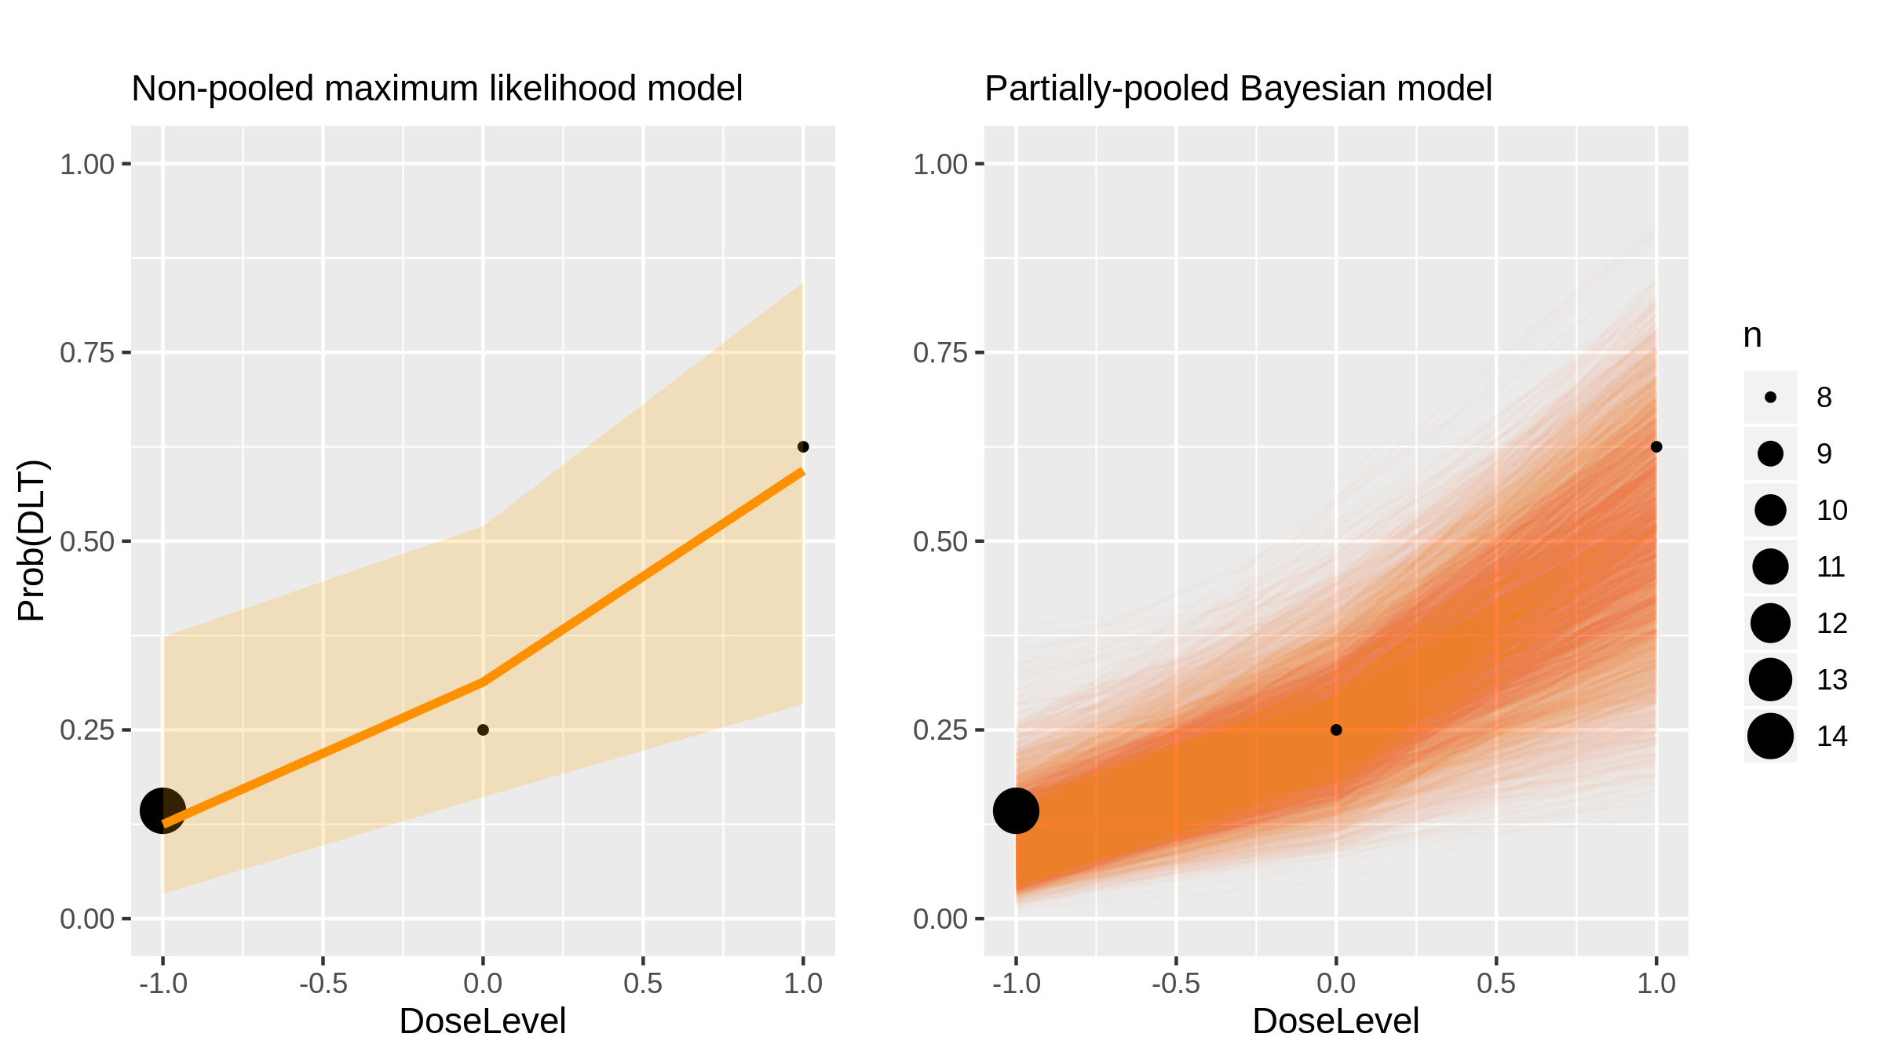
Sonidegib (Inhibitor) in Advanced Solid Tumours [Rodon2014a_2]

Slide 11
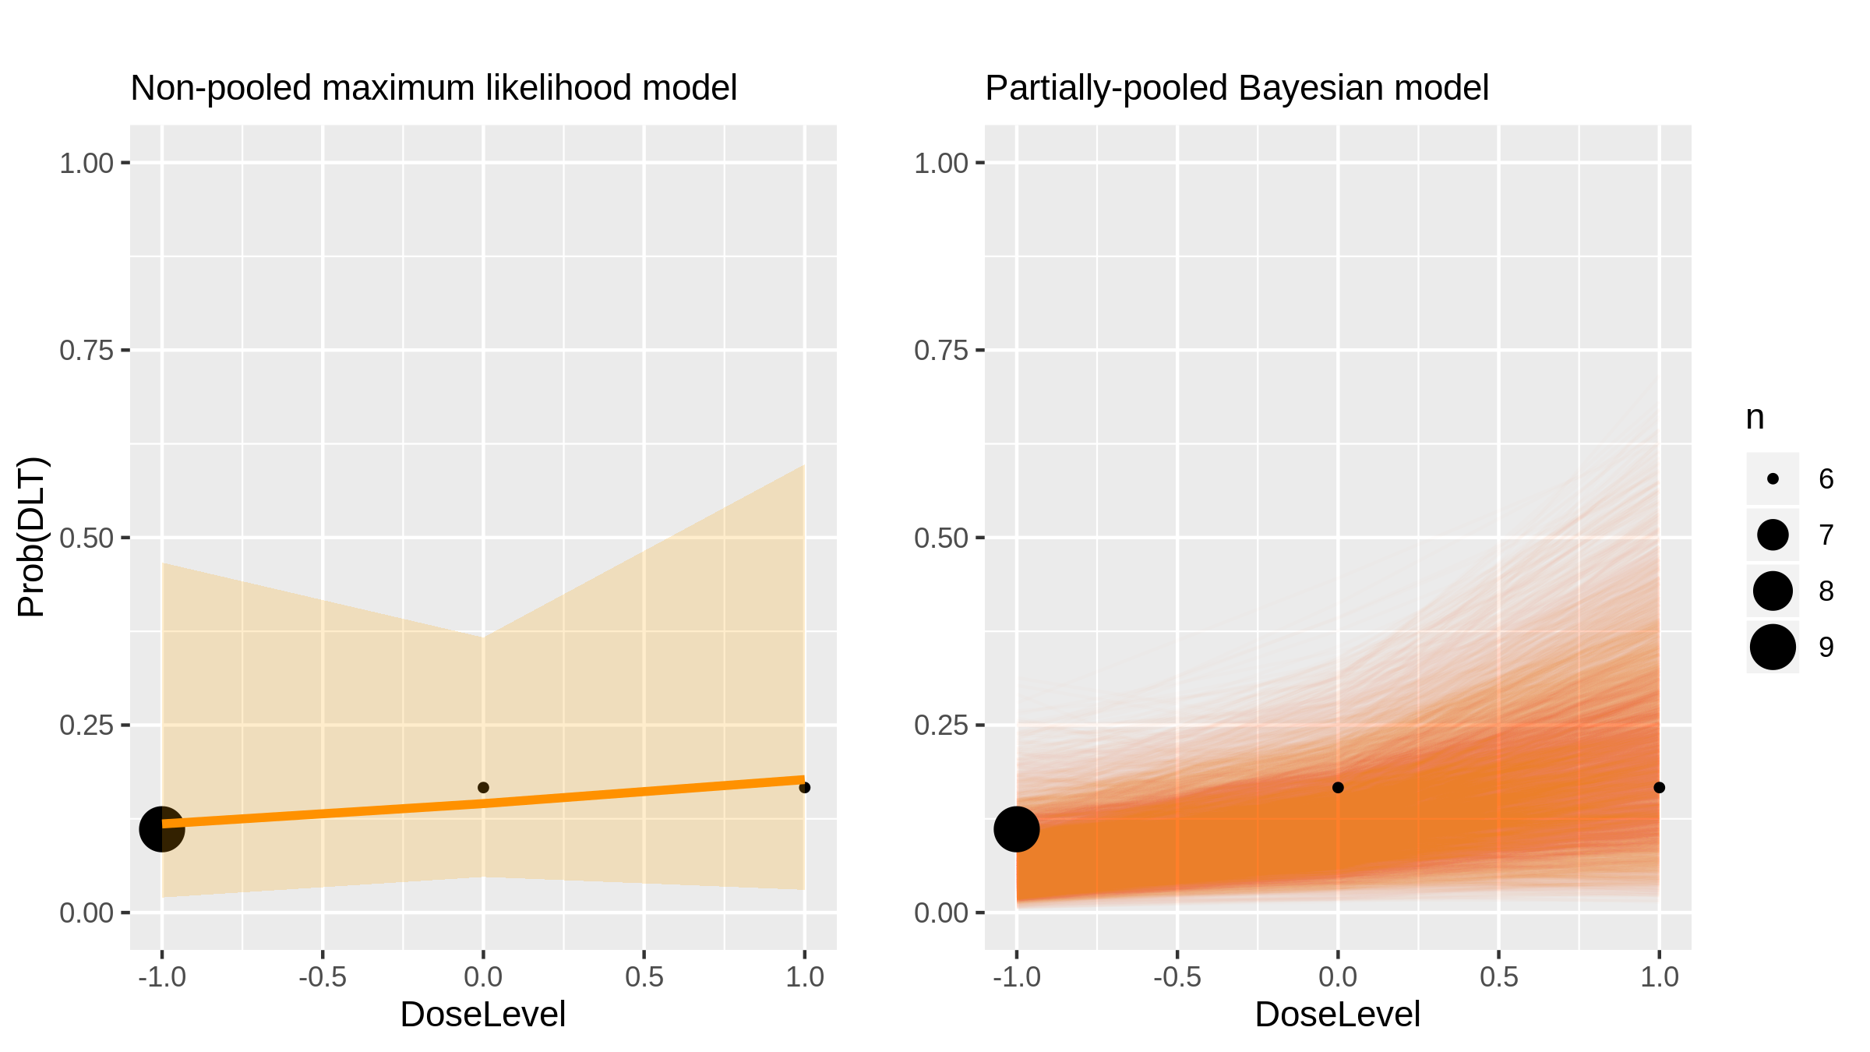
Idarubicin (Chemotherapy) in Hepatocellular Carcinoma [Boulin2014_1]

Slide 12
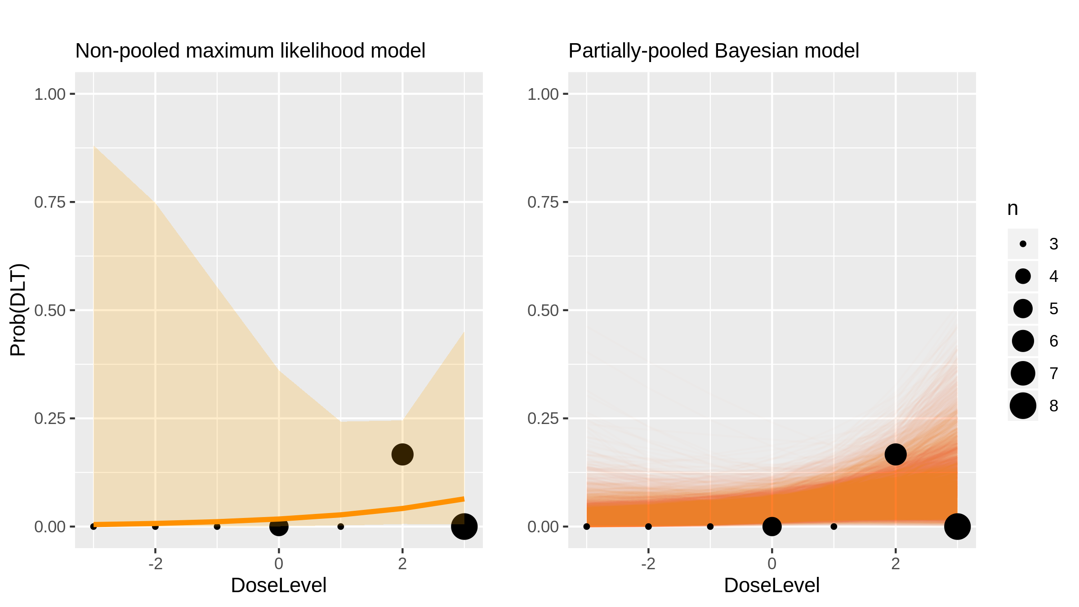
AUY922 (Inhibitor) in Advanced Solid Tumours [Doi2014_1]

Slide 13
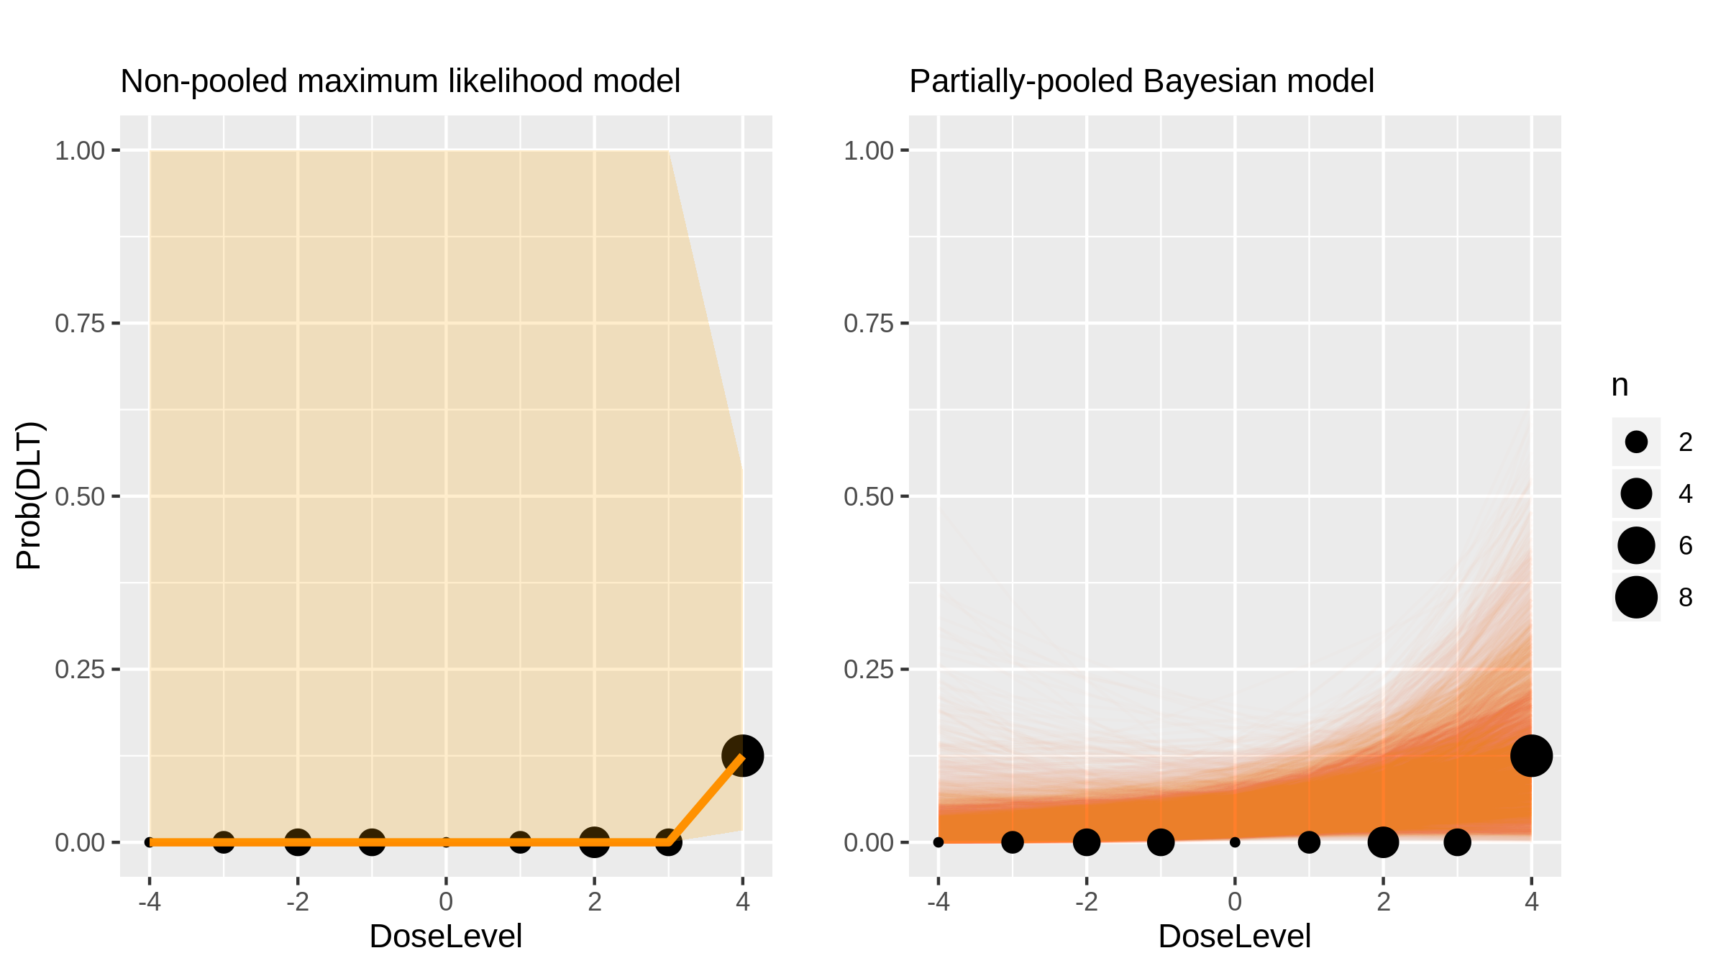
LCL161 (Inhibitor) in Advanced Solid Tumours [Infante2014_1]

Slide 14
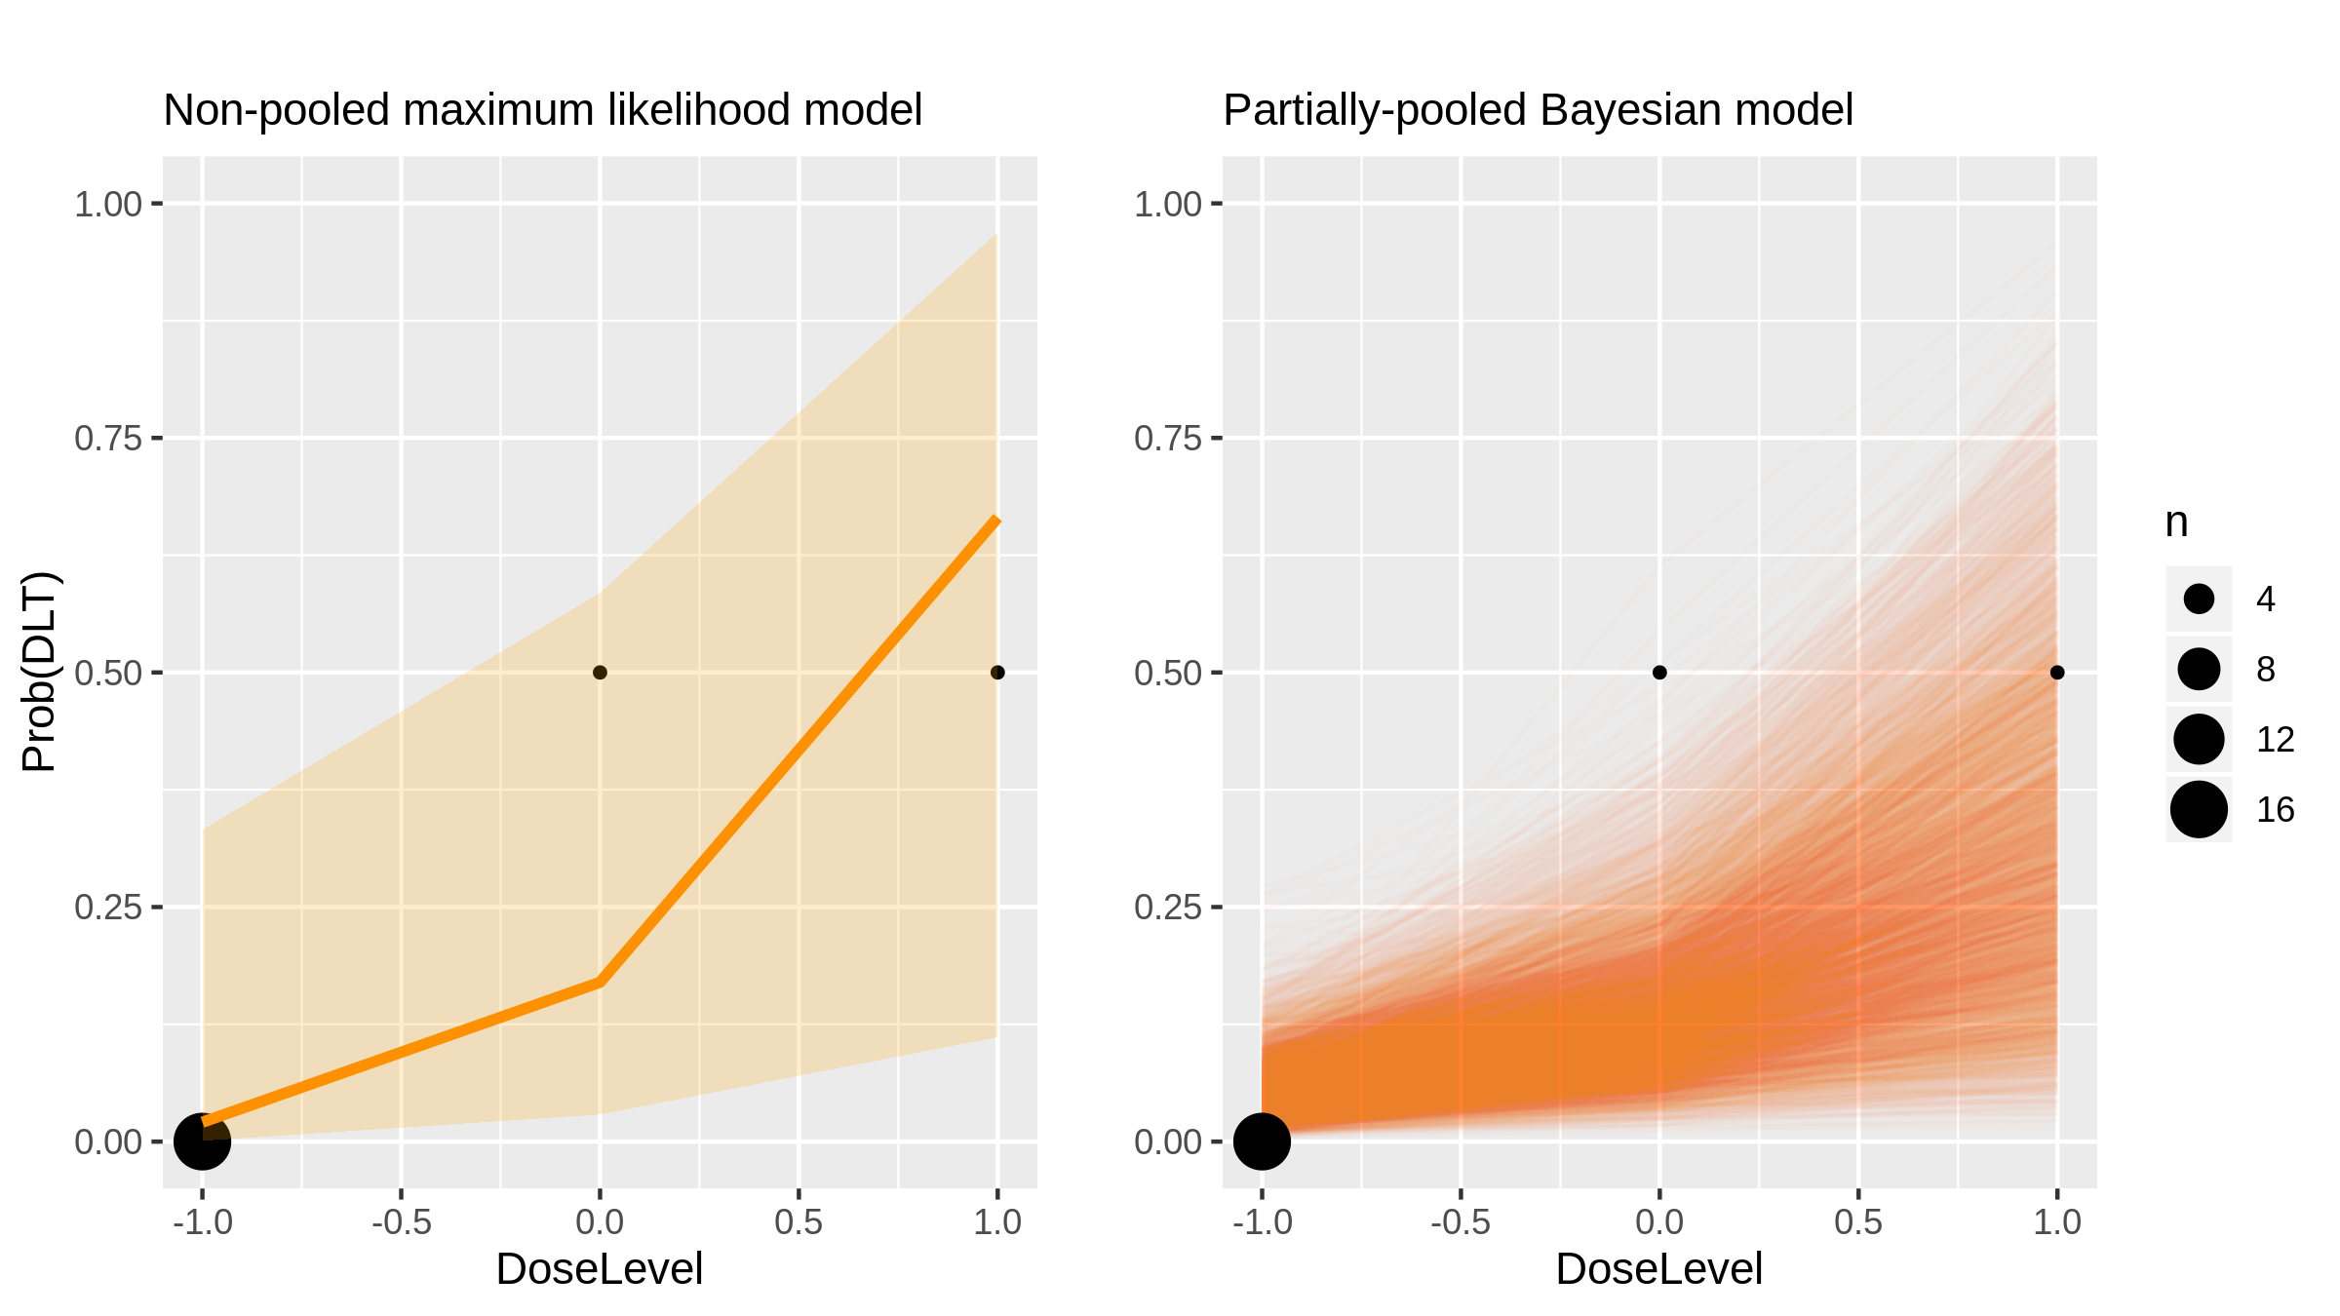
LCL161 (Inhibitor) in Advanced Solid Tumours [Infante2014_2]

Slide 15
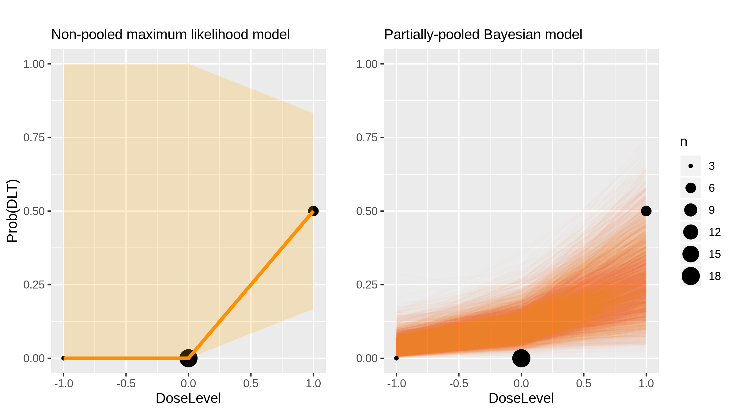
Oxaliplatin (Chemotherapy) in Aml [Tsimberidou2014_1]

Slide 16
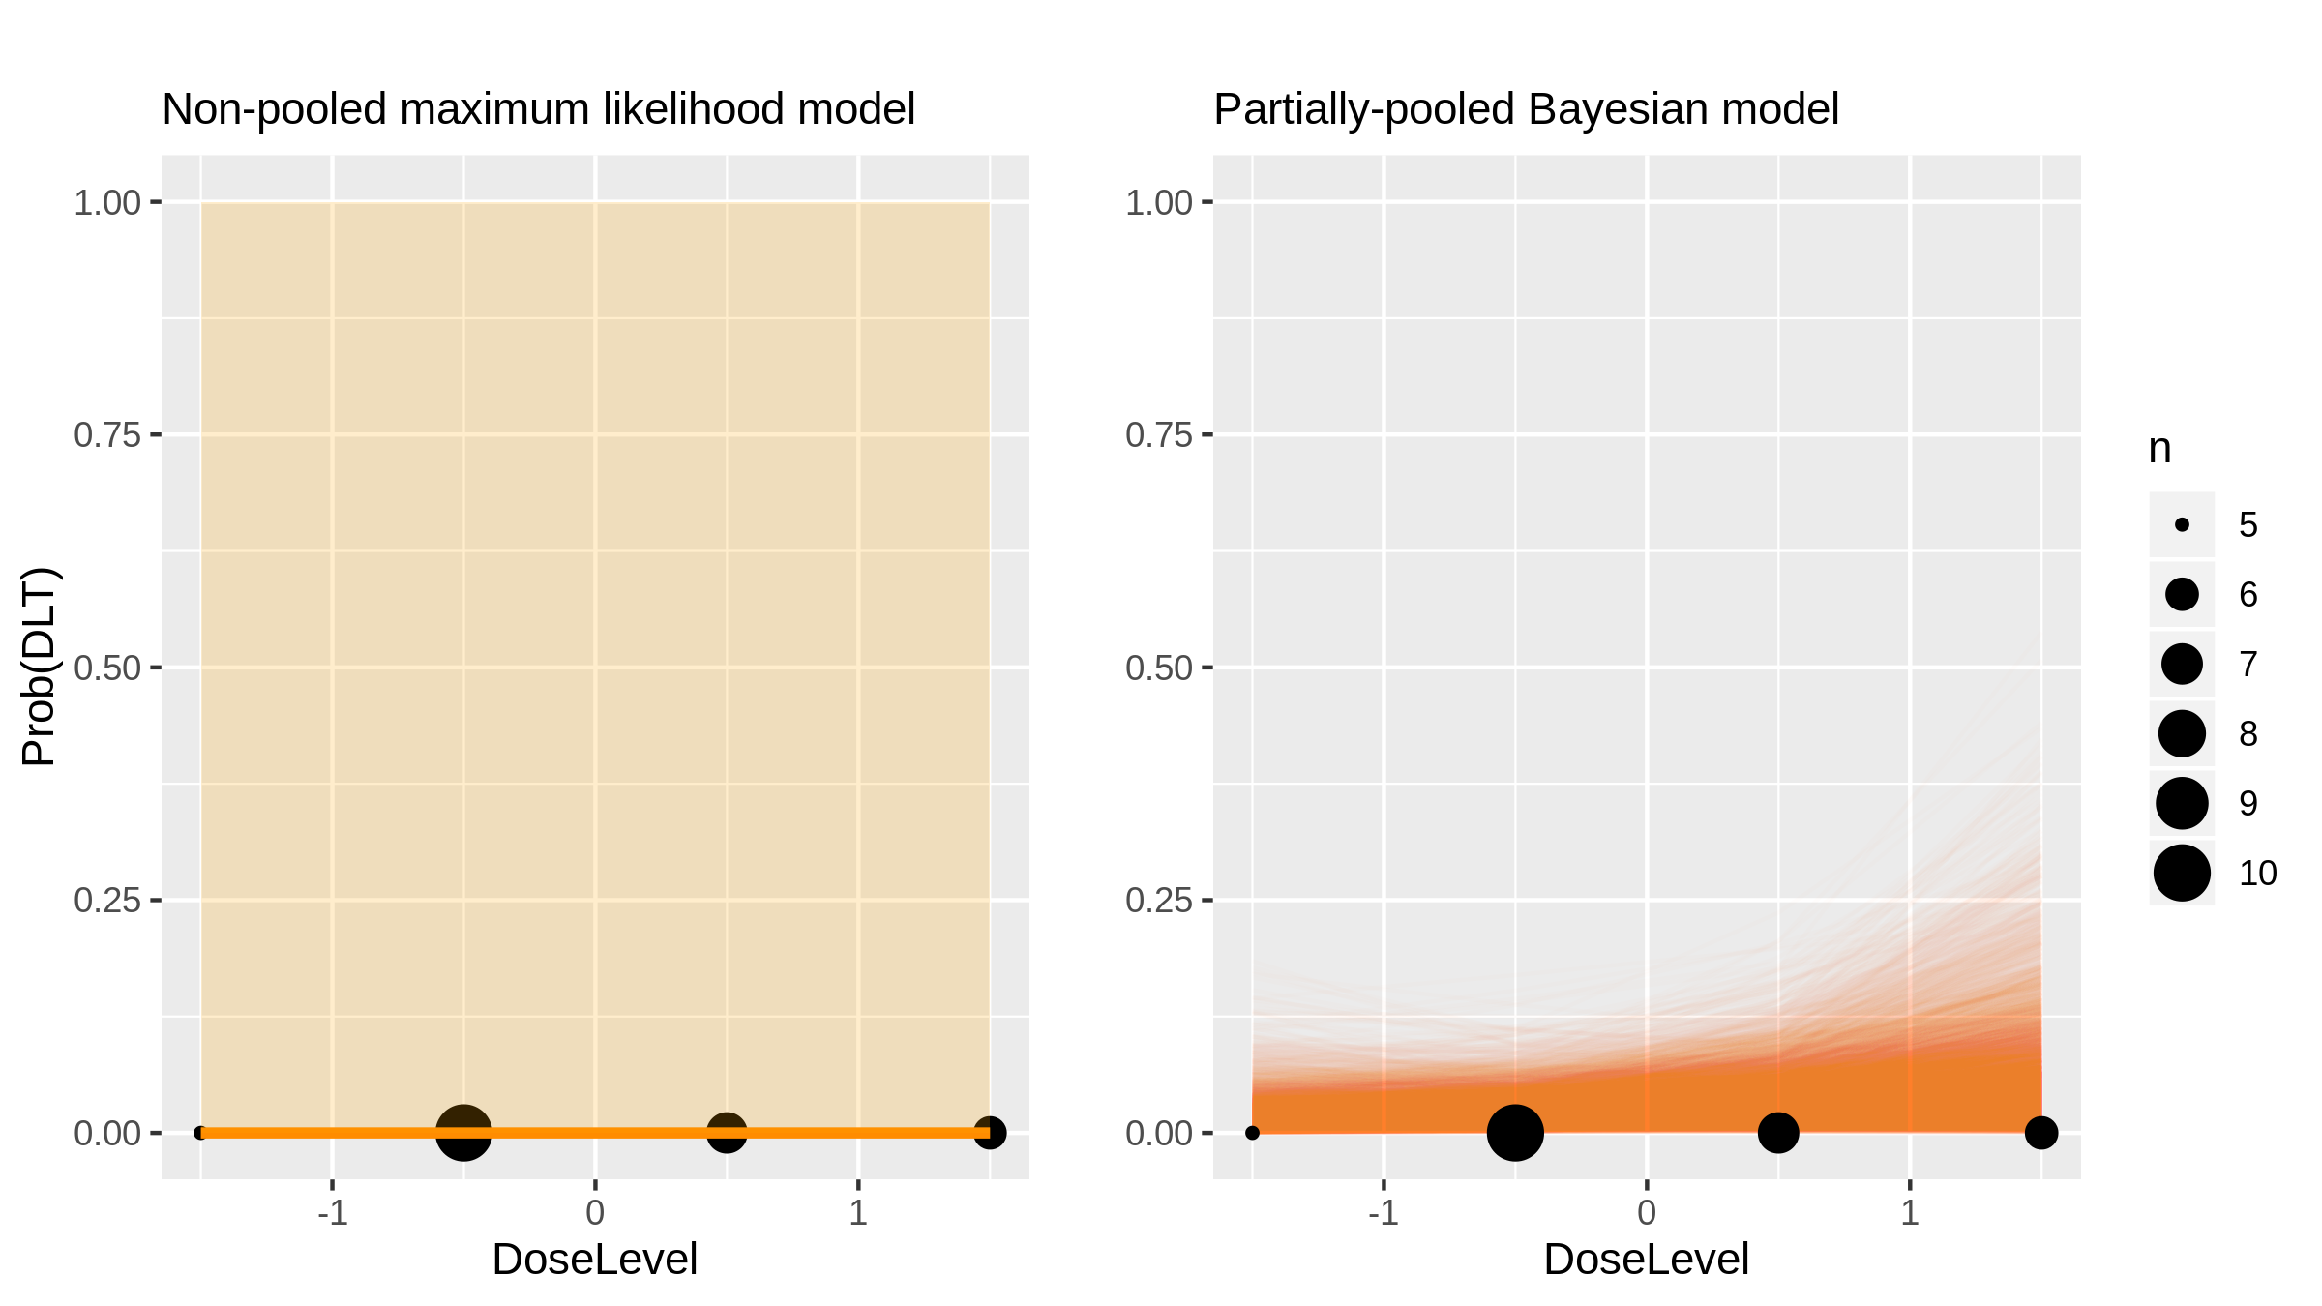
BHQ880 (Monoclonal Antibody) in Multiple Myeloma [Iyer2014_1]

Slide 17
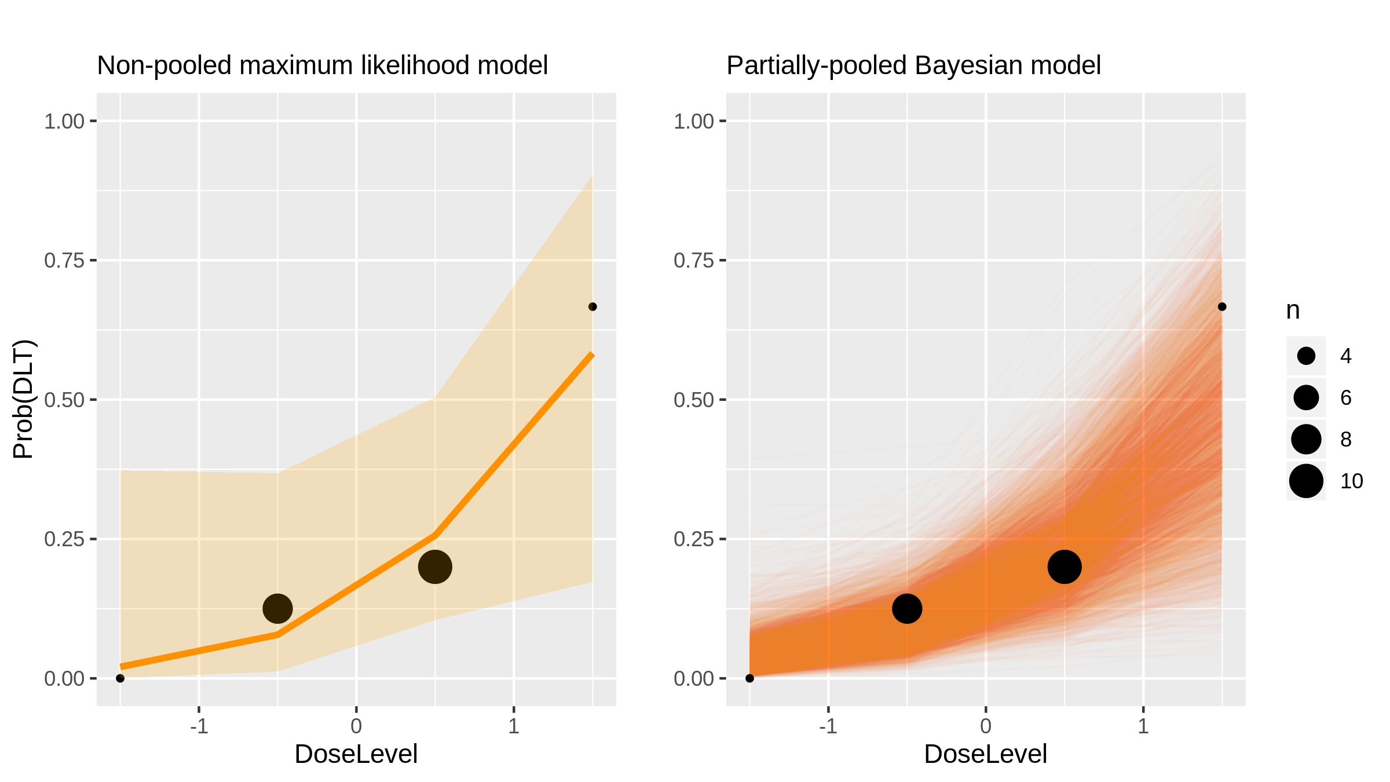
MK-2206 (Inhibitor) in Advanced Solid Tumours [Brana2014_1]

Slide 18
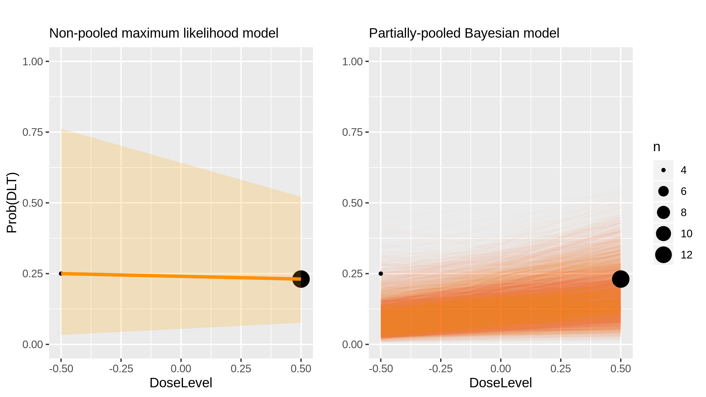
Dalotuzumab (Monoclonal Antibody) in Advanced Solid Tumours [Brana2014_2]

Slide 19
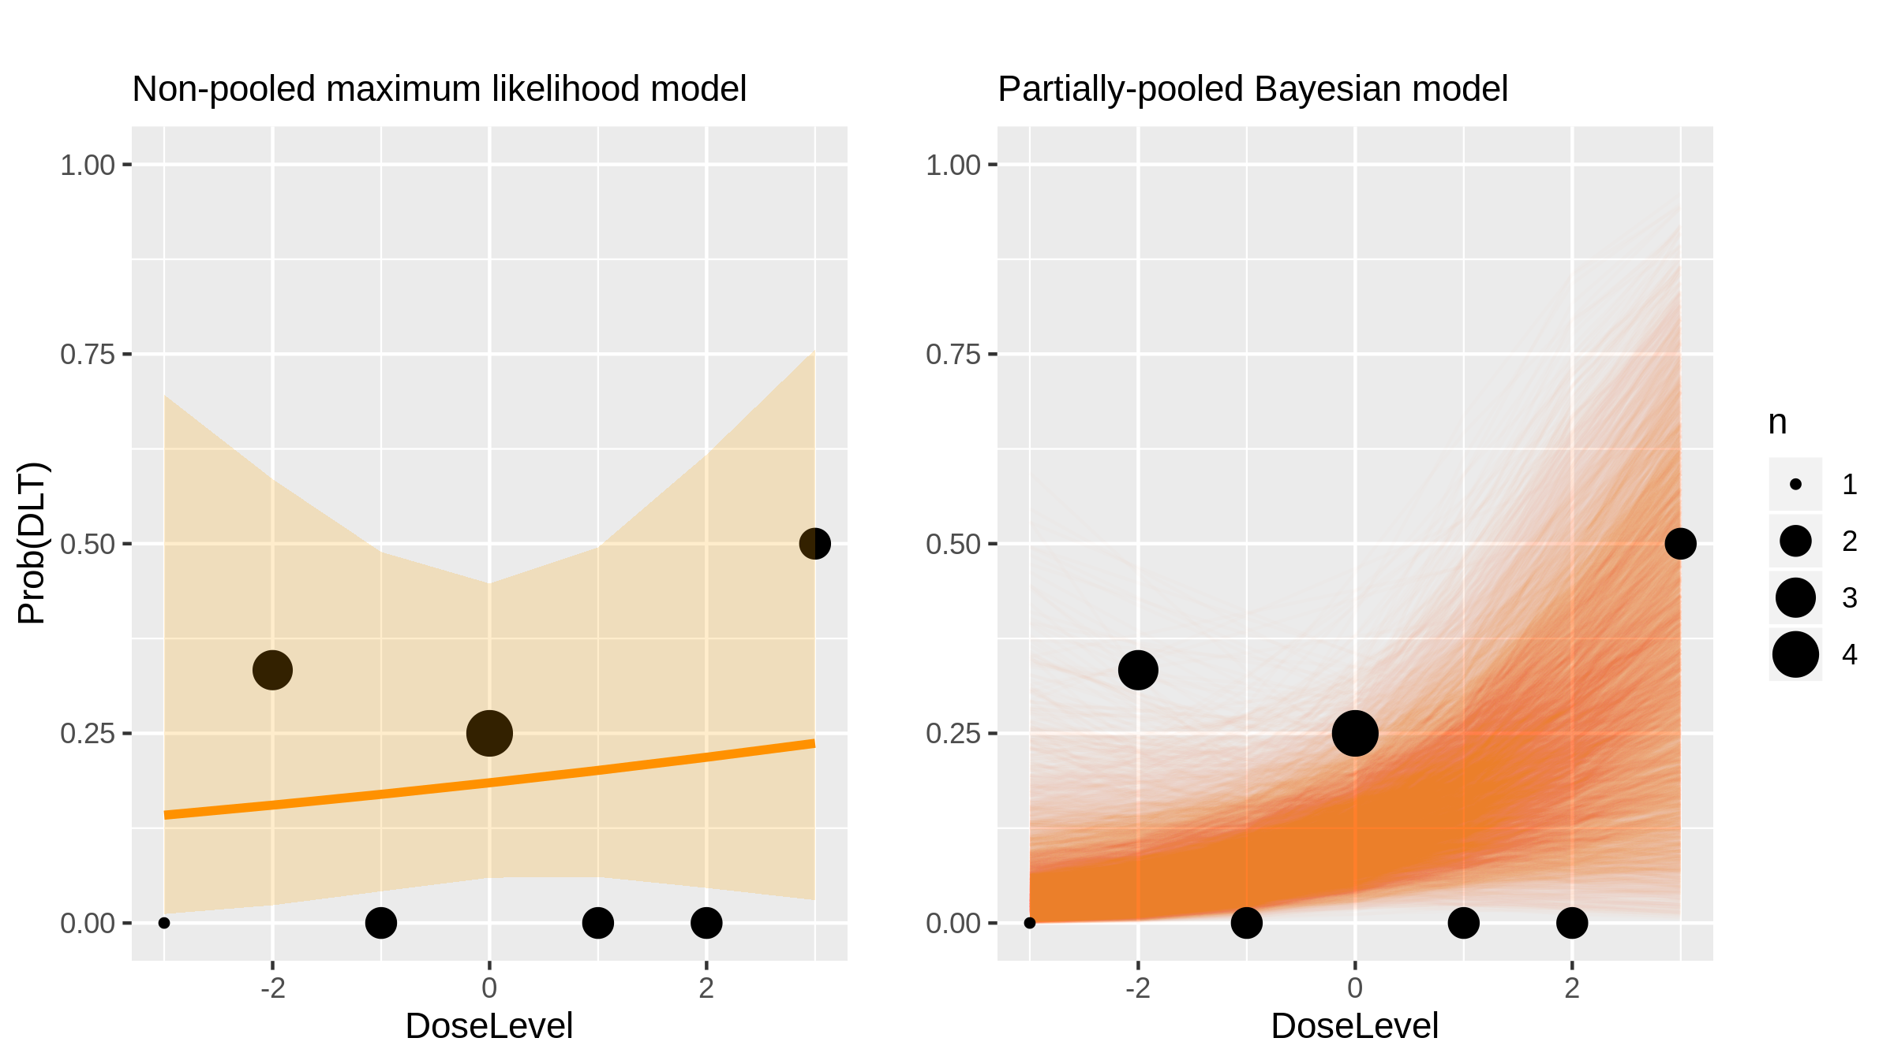
Irinotecan (Chemotherapy) in Children With Refractory Solid Tumours [Brennan2014_1]

Slide 20
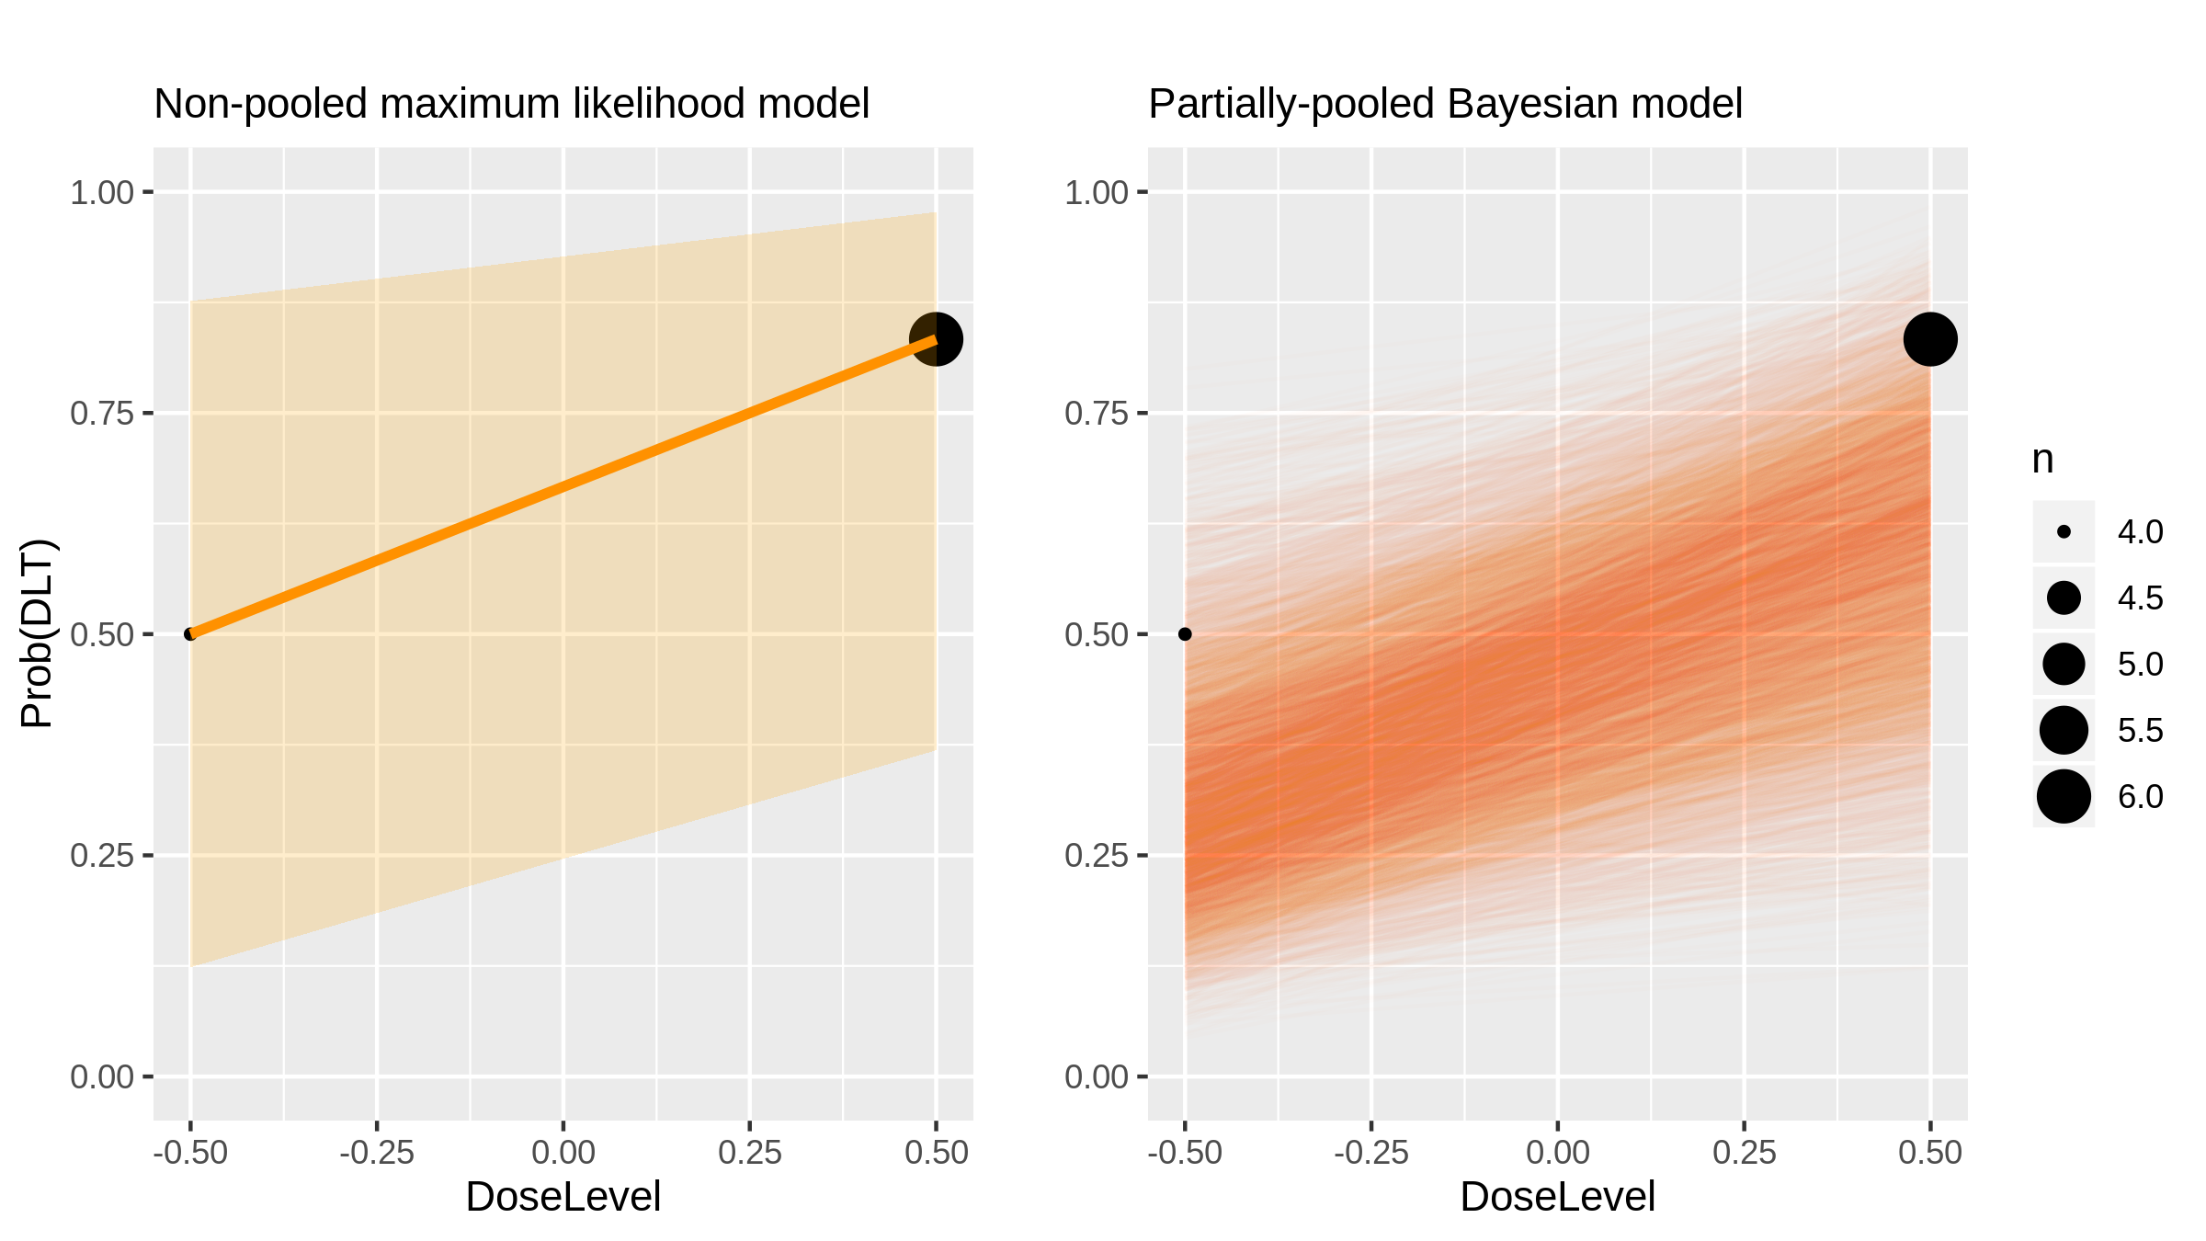
Everolimus (Inhibitor) in Sclc [Besse2014_1]

Slide 21
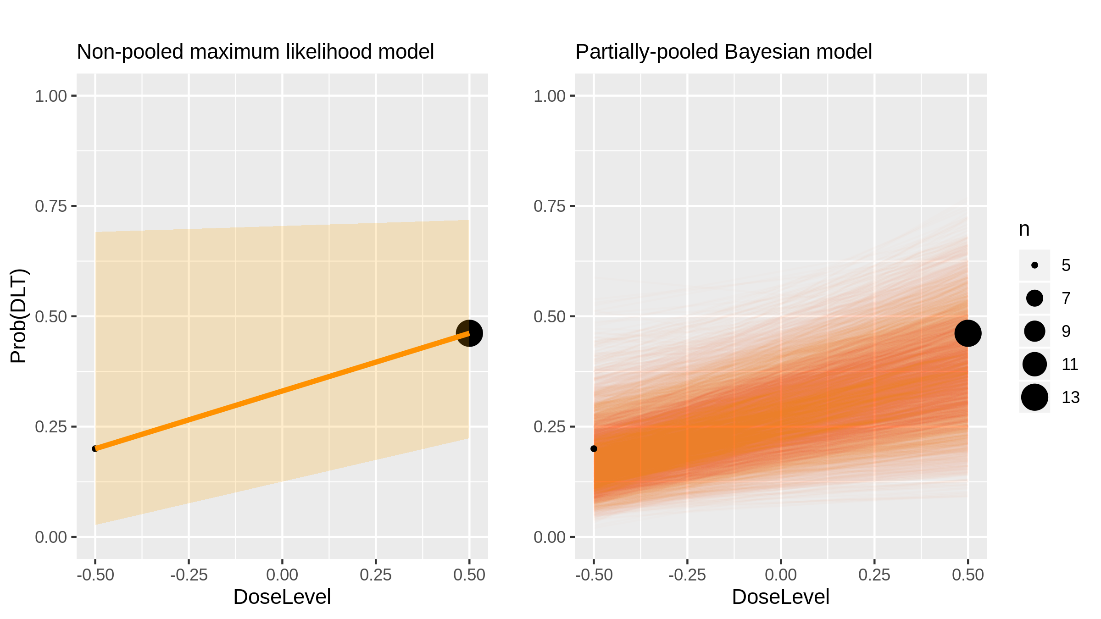
Everolimus (Inhibitor) in Sclc [Besse2014_2]

Slide 22
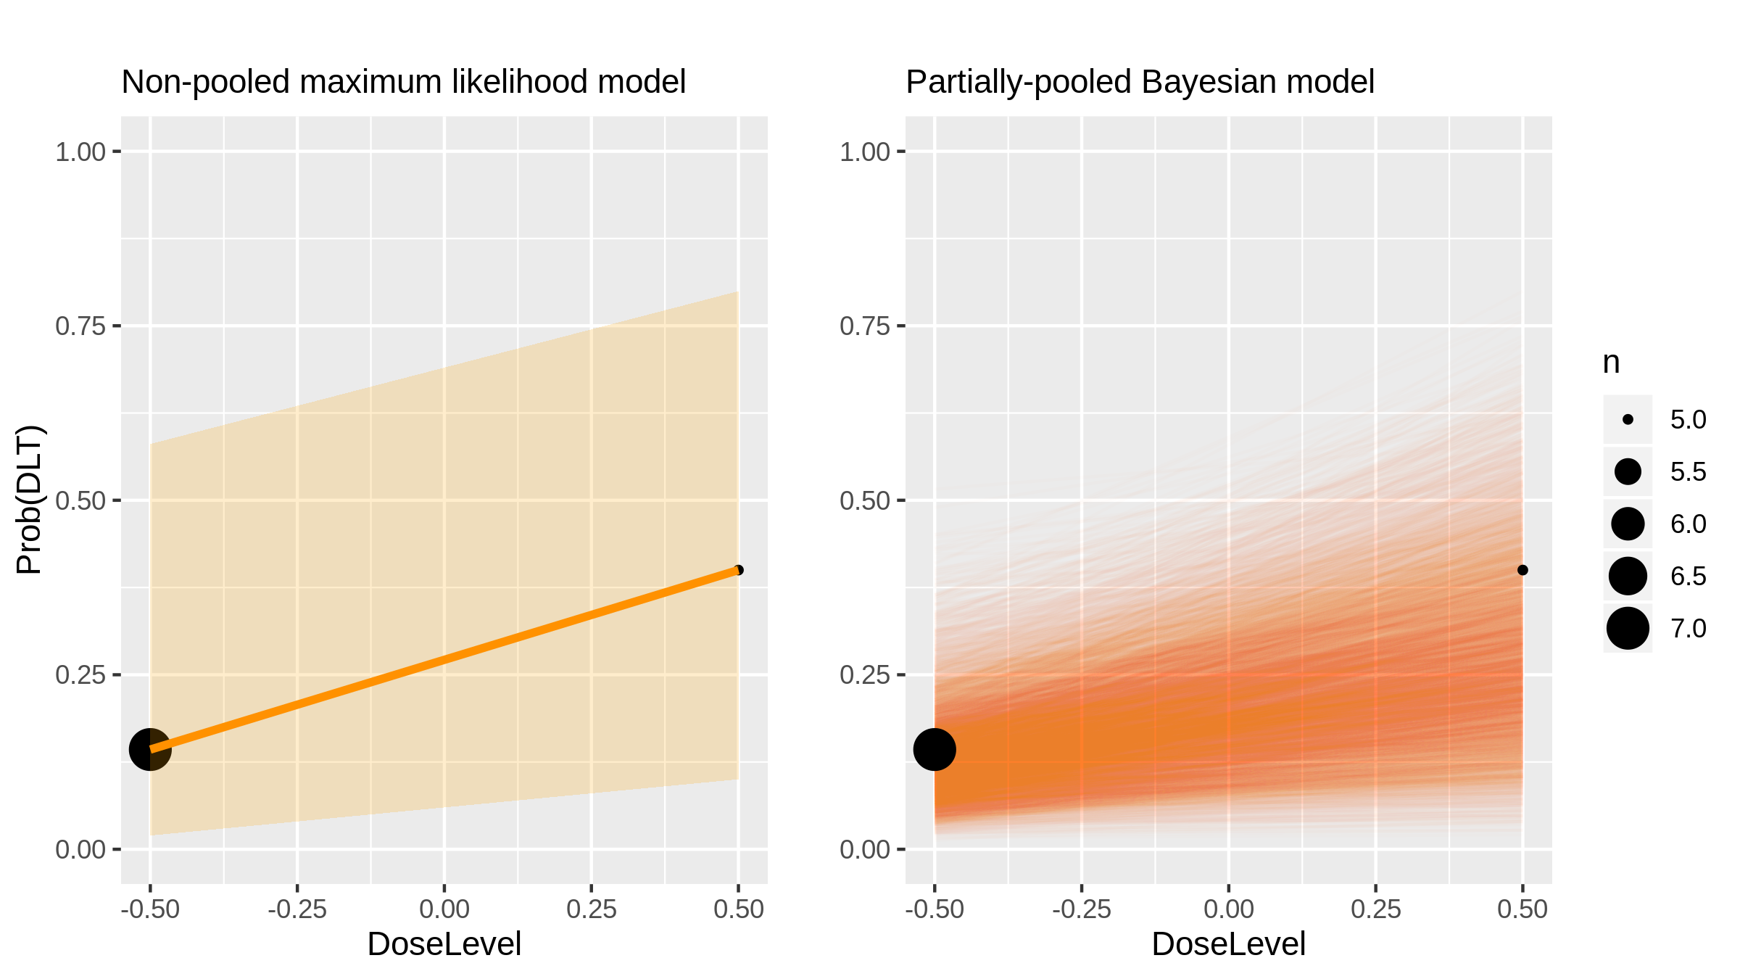
Everolimus (Inhibitor) in Sclc [Besse2014_3]

Slide 23
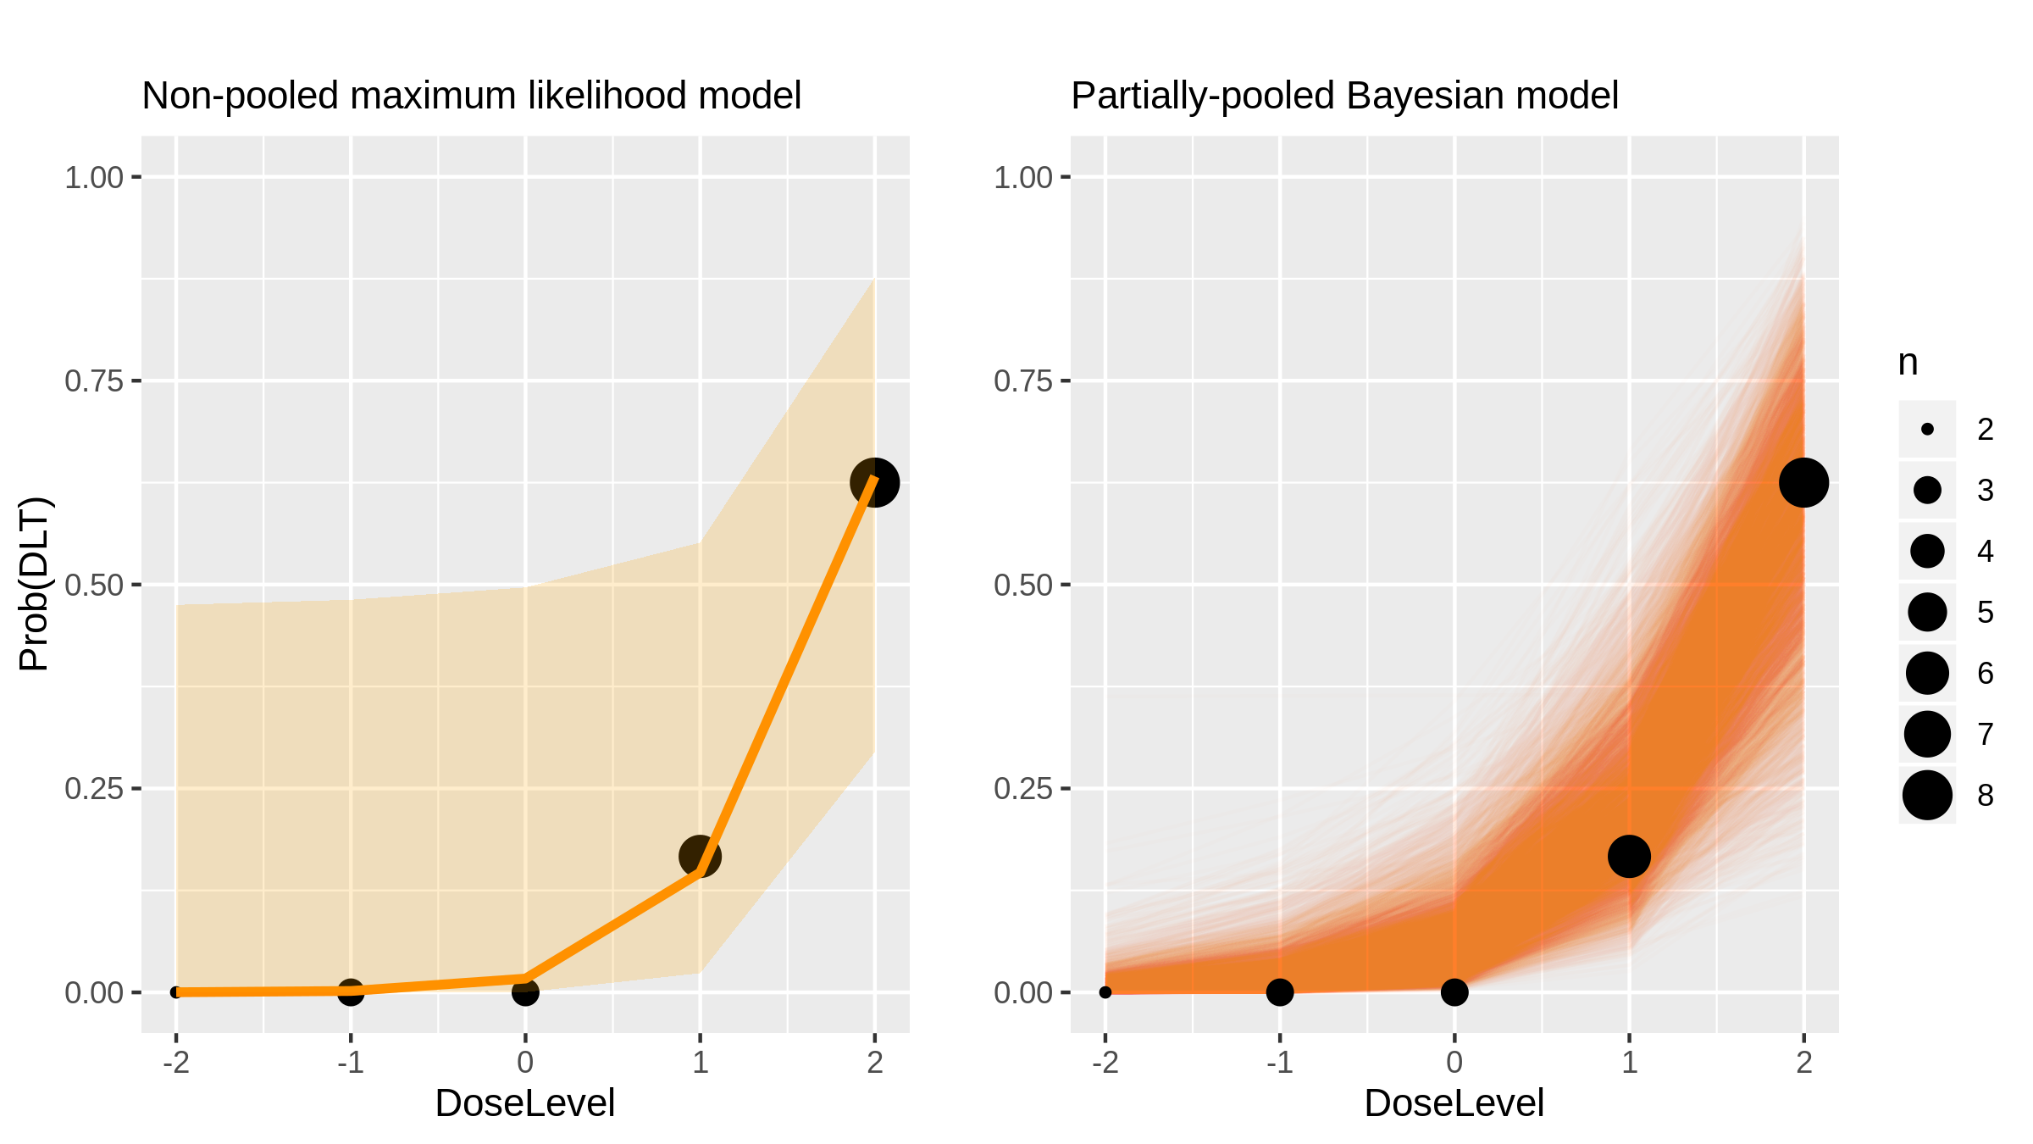
Panobinostat (Chemotherapy) in Lymphoma And Advanced Solid Tumours [Sharma2013_1]

Slide 24
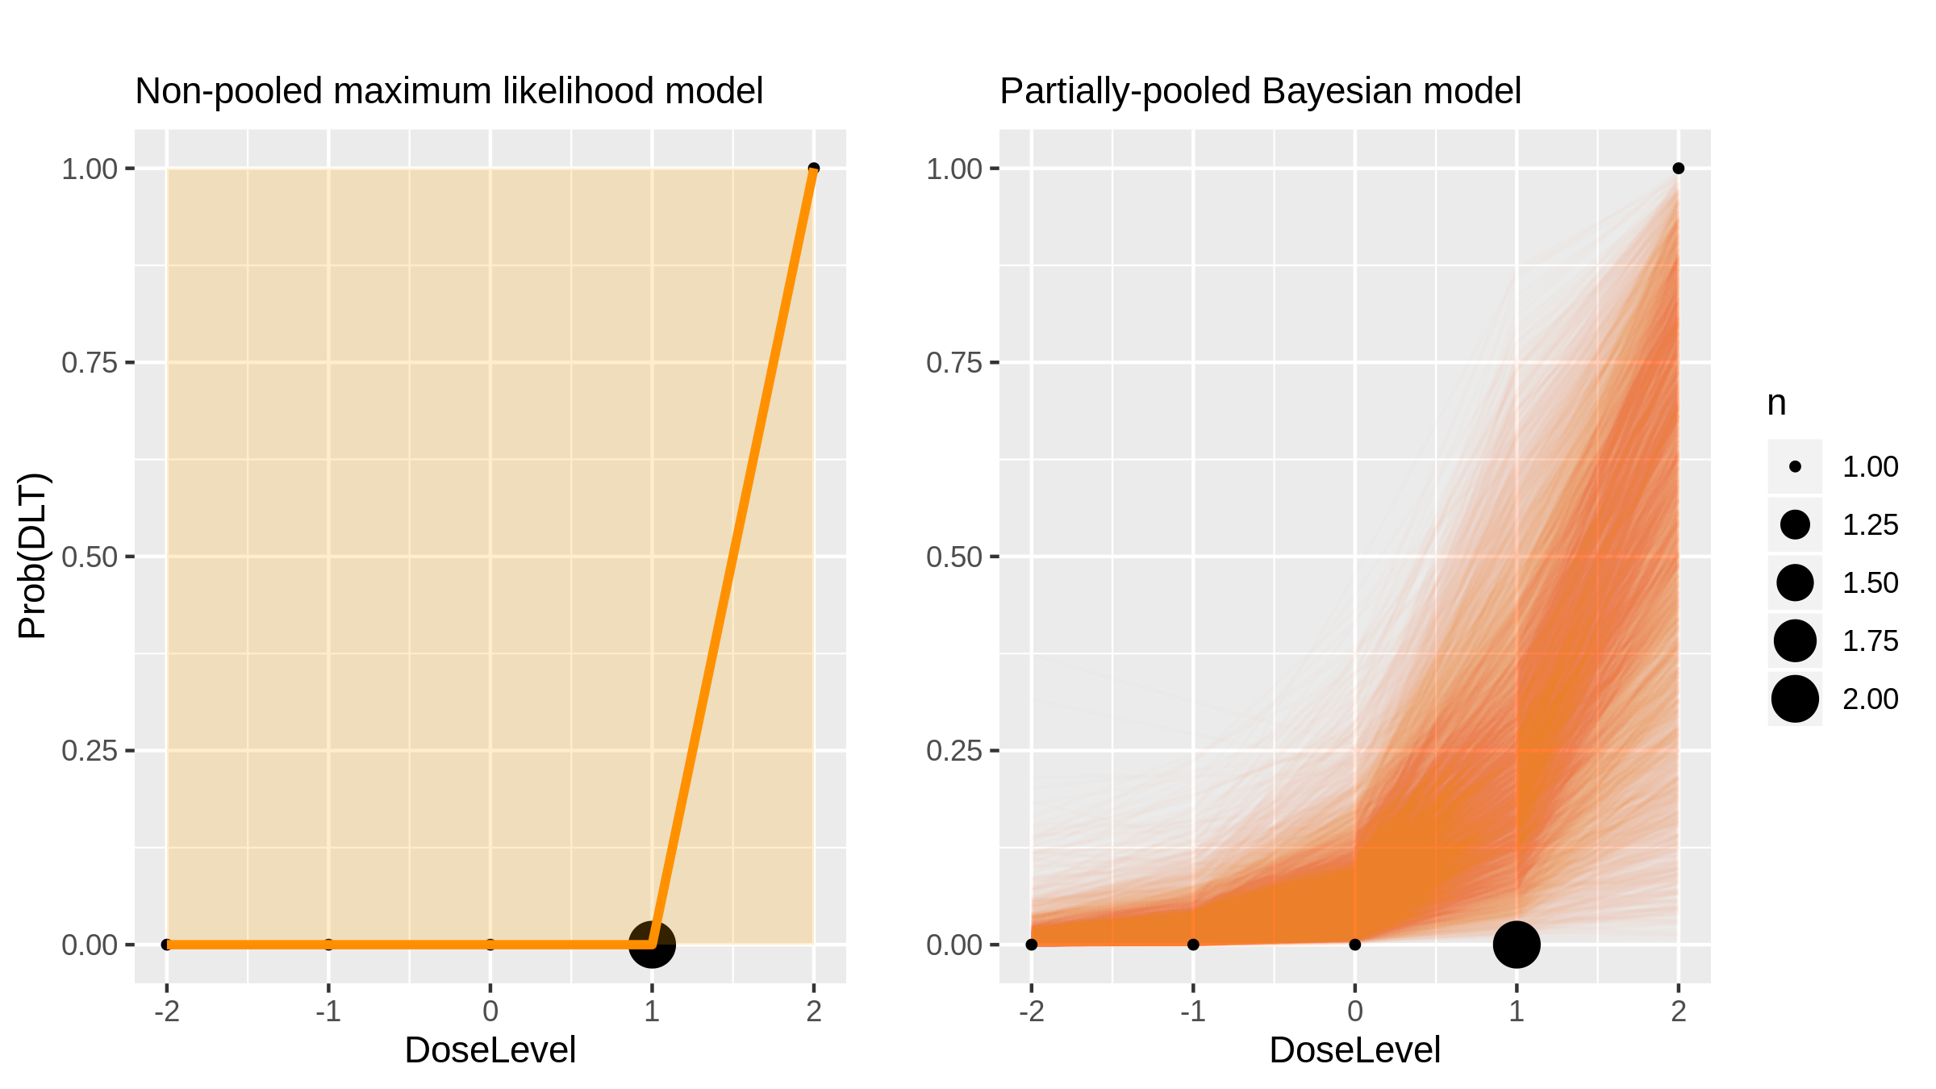
Panobinostat (Chemotherapy) in Lymphoma And Advanced Solid Tumours [Sharma2013_2]

Slide 25
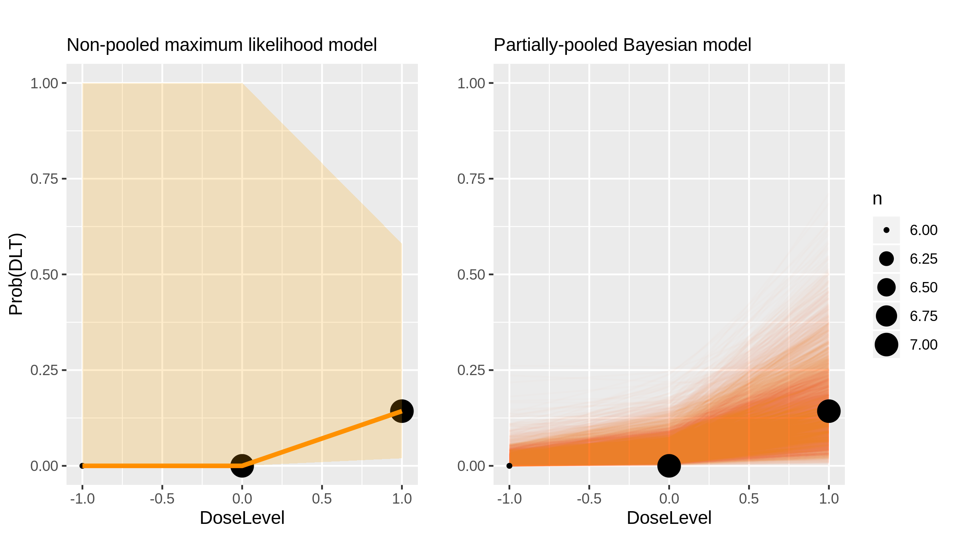
Panobinostat (Chemotherapy) in Lymphoma And Advanced Solid Tumours [Sharma2013_3]

Slide 26
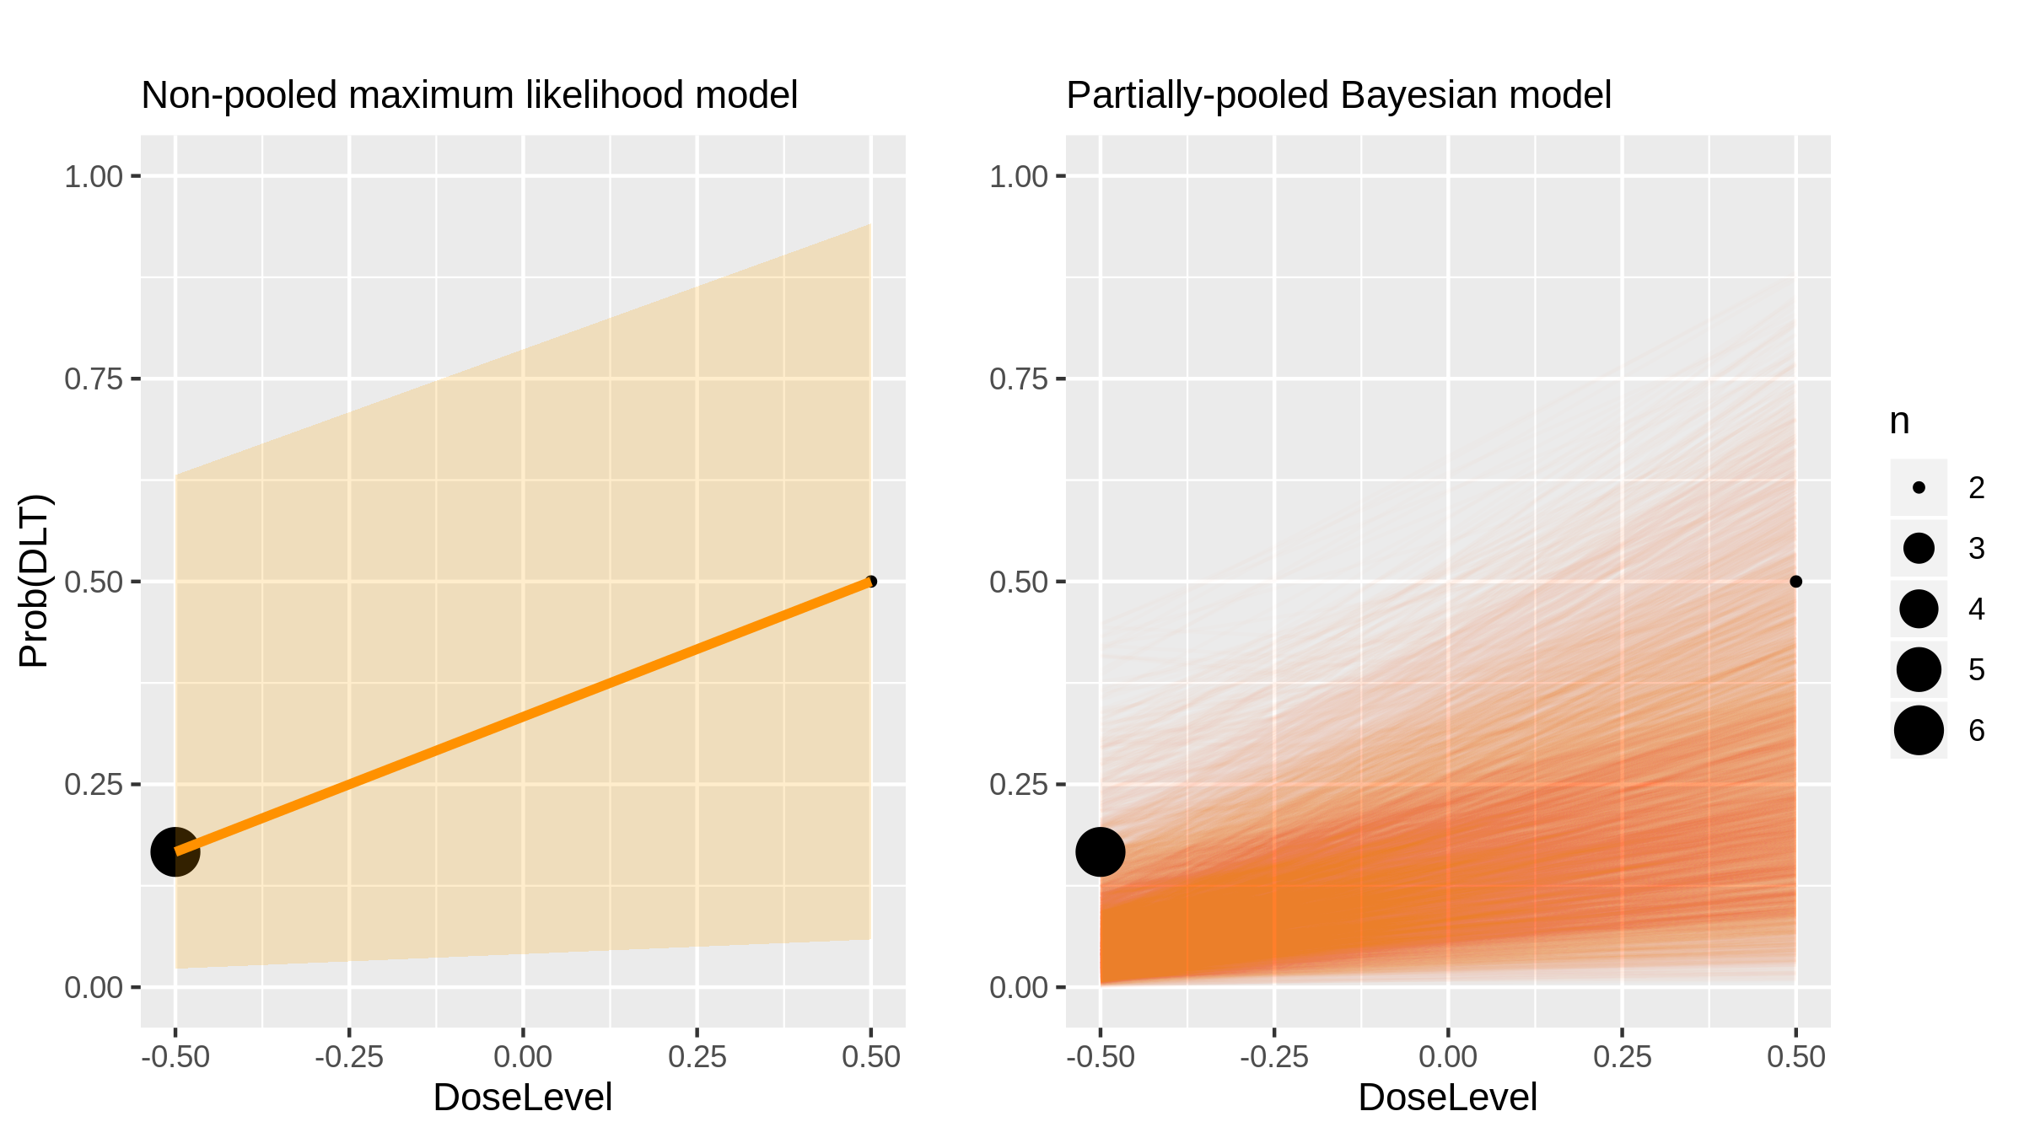
Panobinostat (Chemotherapy) in Lymphoma And Advanced Solid Tumours [Sharma2013_4]

Slide 27
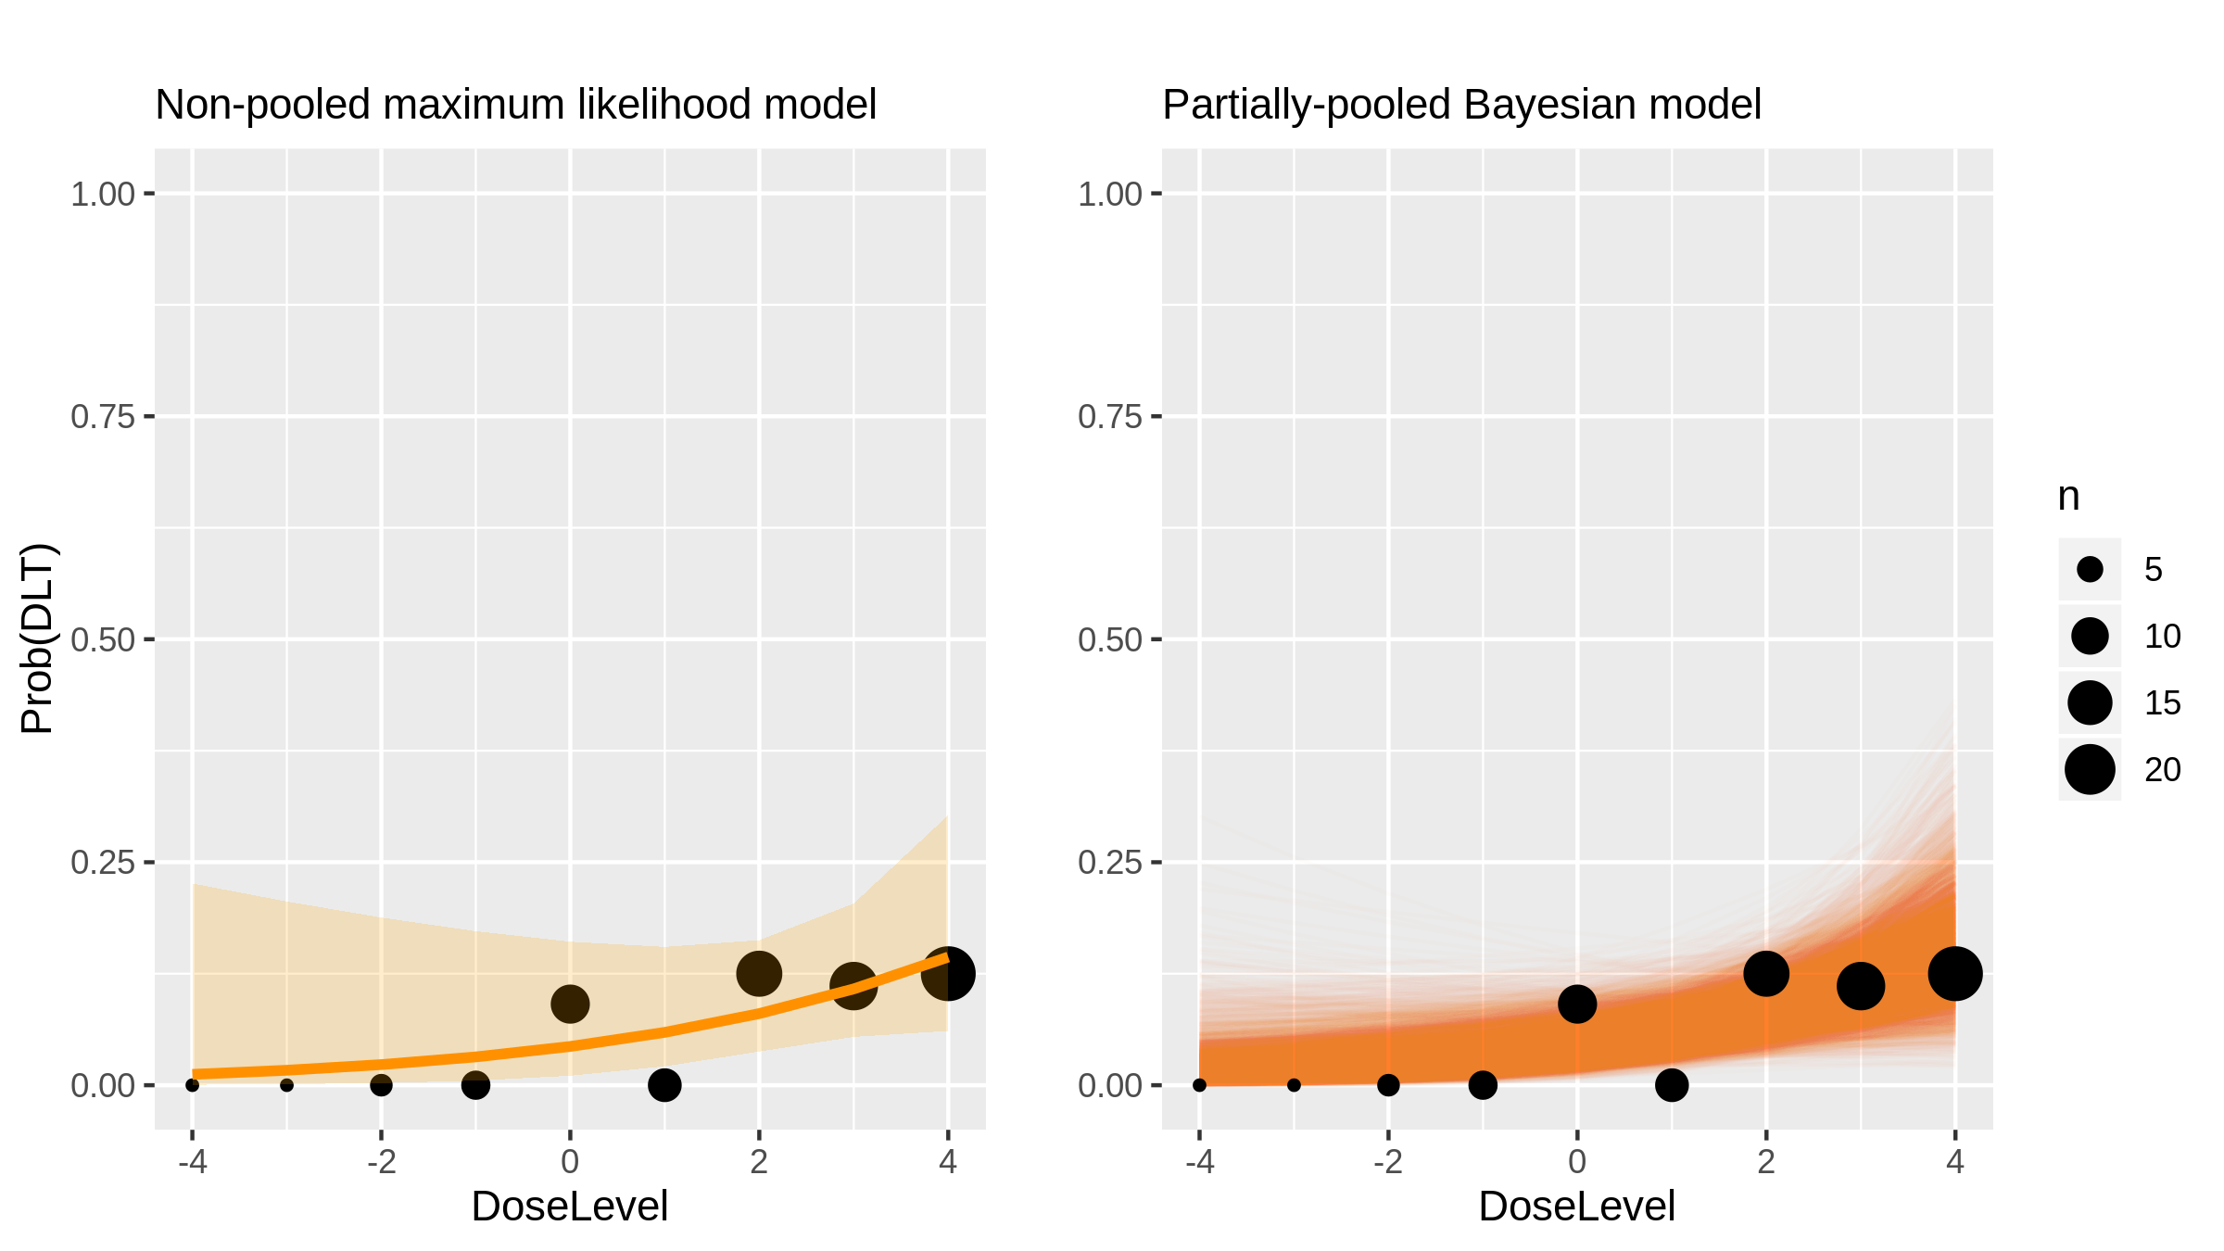
AUY922 (Inhibitor) in Advanced Solid Tumours [Sessa2013_1]

Slide 28
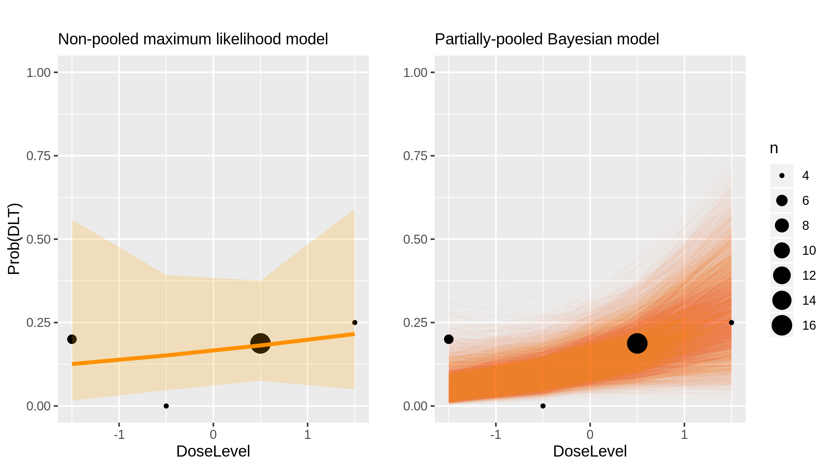
Gamma secretase inhibitors: MK-0752 (Inhibitor) in Breast Cancer [Schott2013_1]

Slide 29
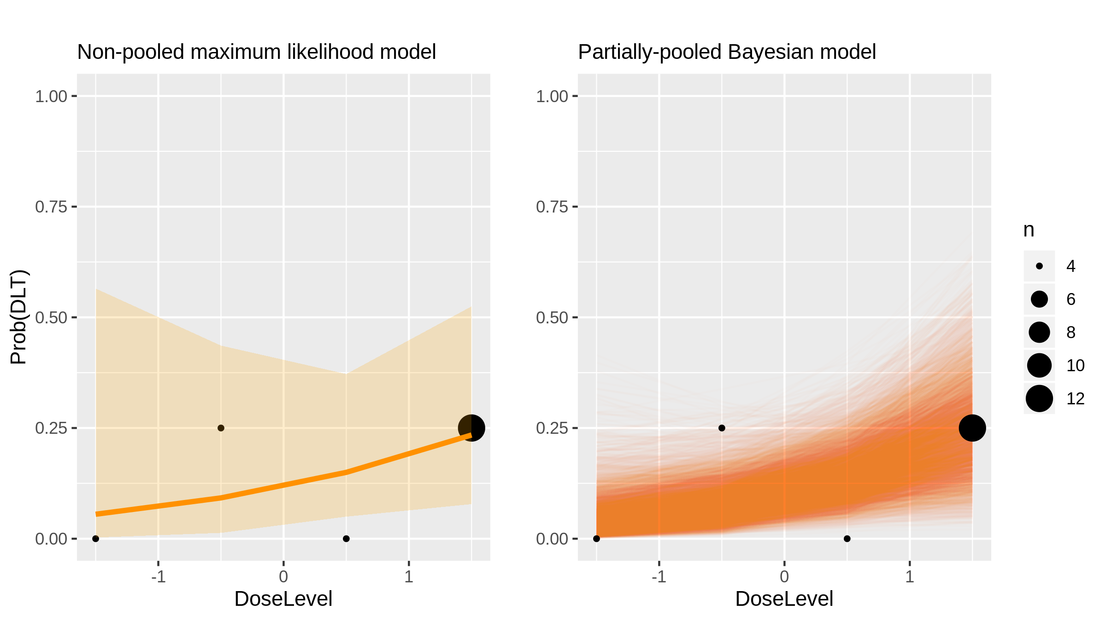
Pomalidomide (Immunomodulatory drug) in Multiple Myeloma [Larocca2013_1]

Slide 30
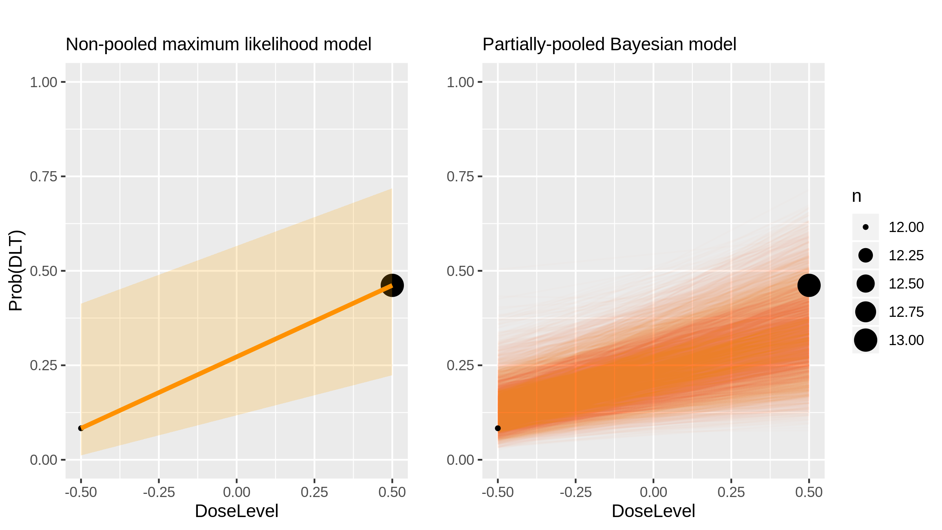
Everolimus (Inhibitor) in Hepatocellular Carcinoma [Finn2013_1]

Slide 31
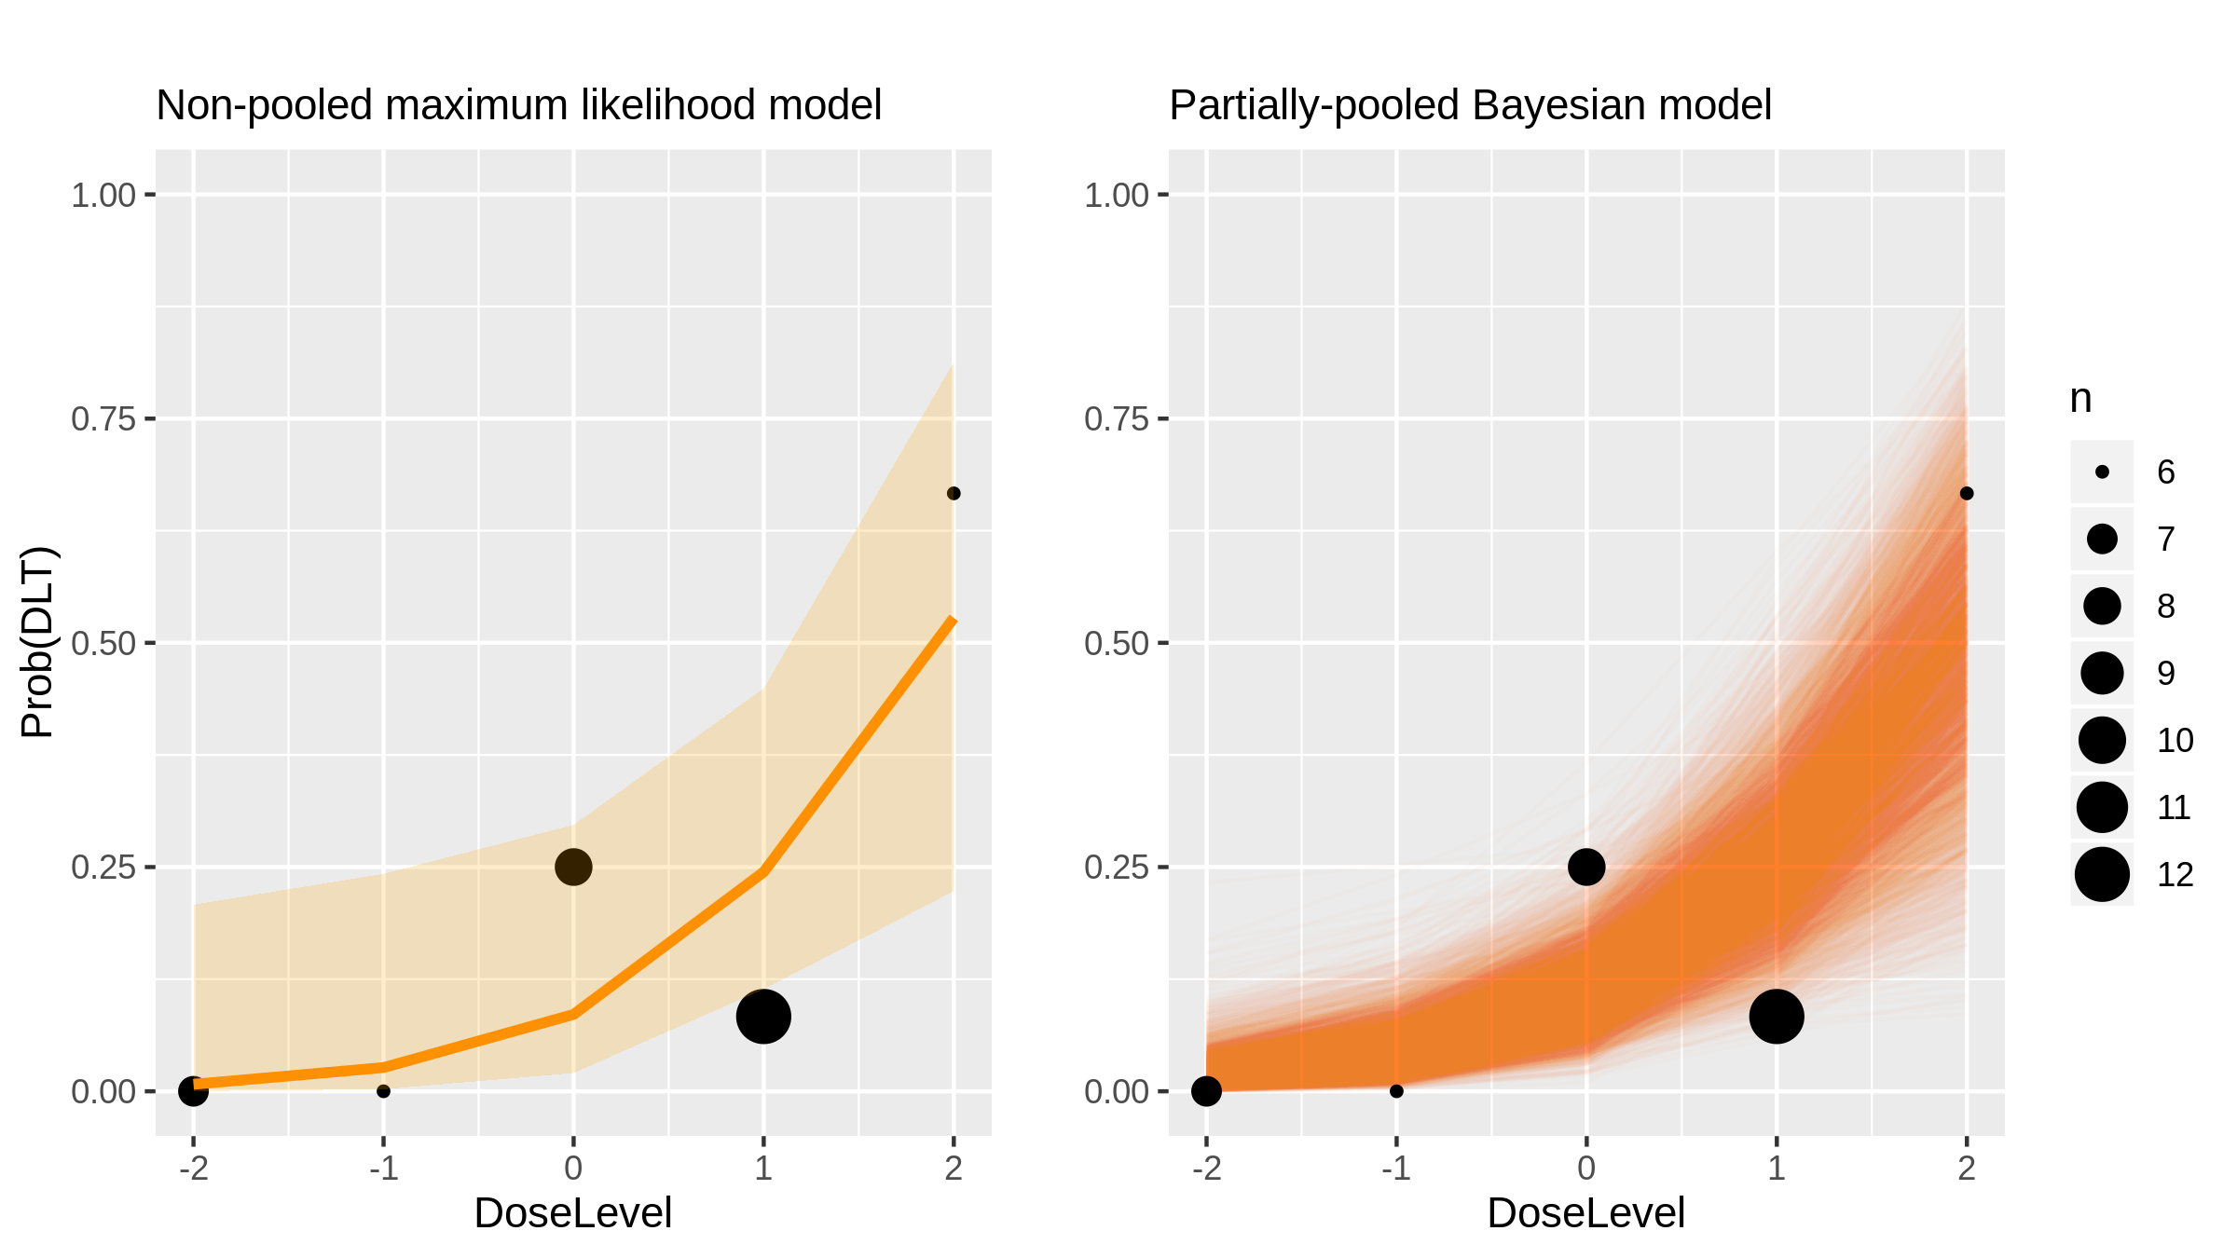
Panobinostat (Chemotherapy) in Blood Cancers [DeAngelo2013_1]

Slide 32
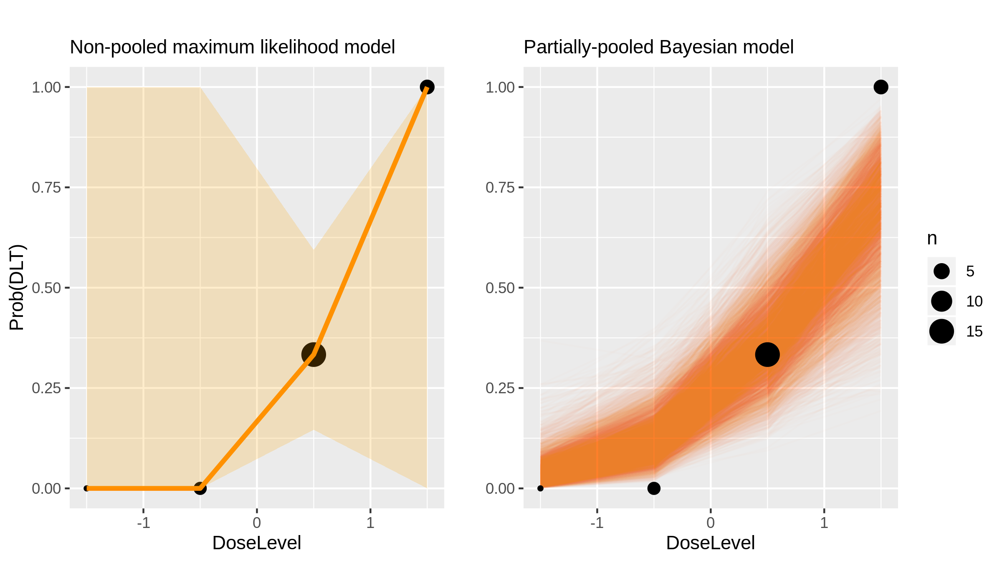
Panobinostat (Chemotherapy) in Blood Cancers [DeAngelo2013_2]

Slide 33
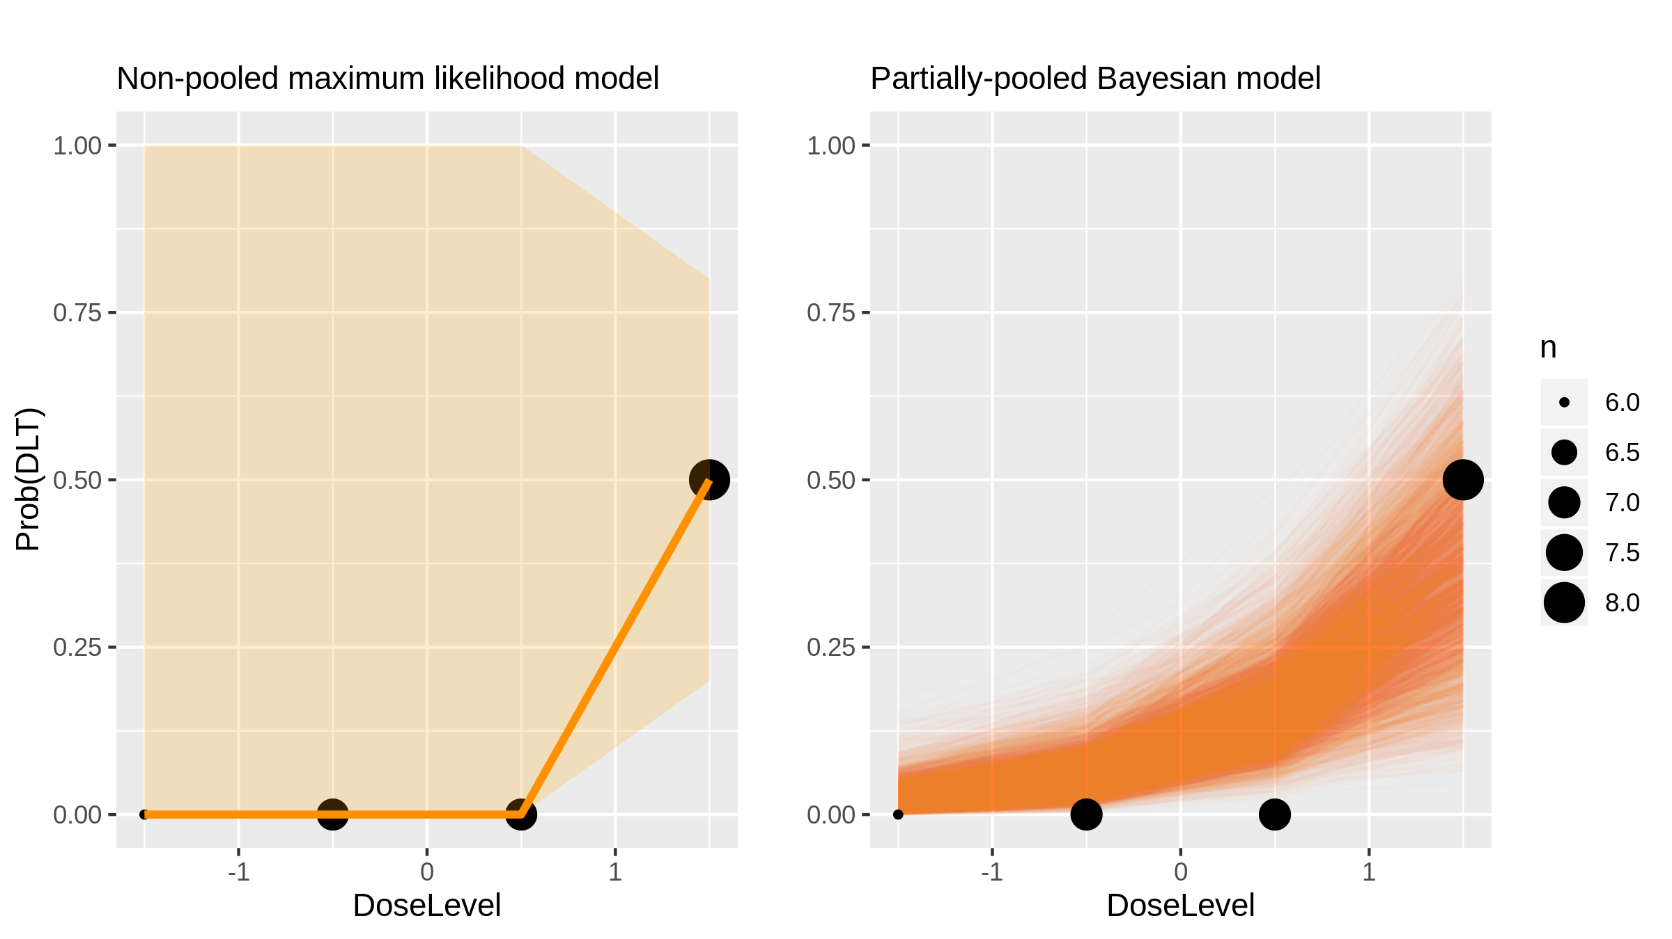
Panobinostat (Chemotherapy) in Blood Cancers [DeAngelo2013_3]

Slide 34
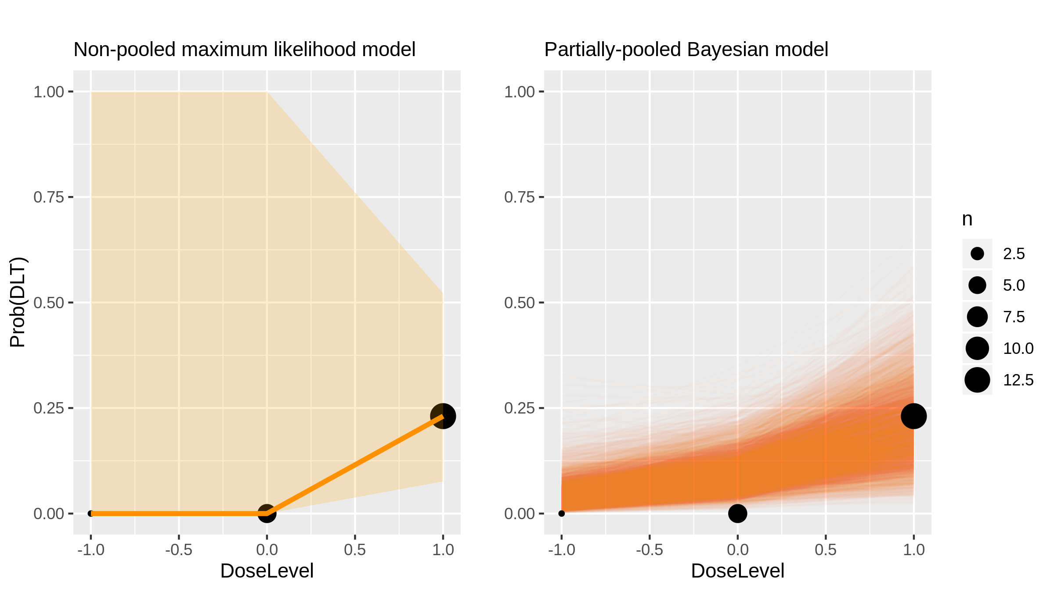
Panobinostat (Chemotherapy) in Blood Cancers [DeAngelo2013_4]

Slide 35
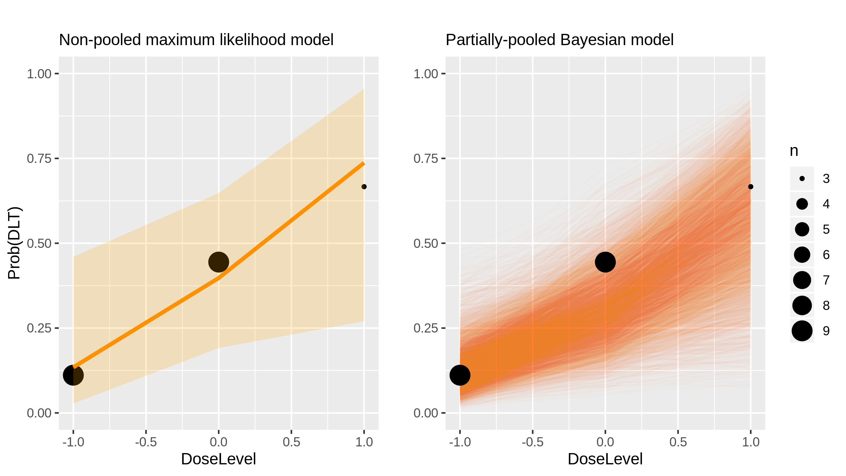
Lenalidomide (Immunomodulatory drug) in Lymphoma [Chiappella2013_1]

Slide 36
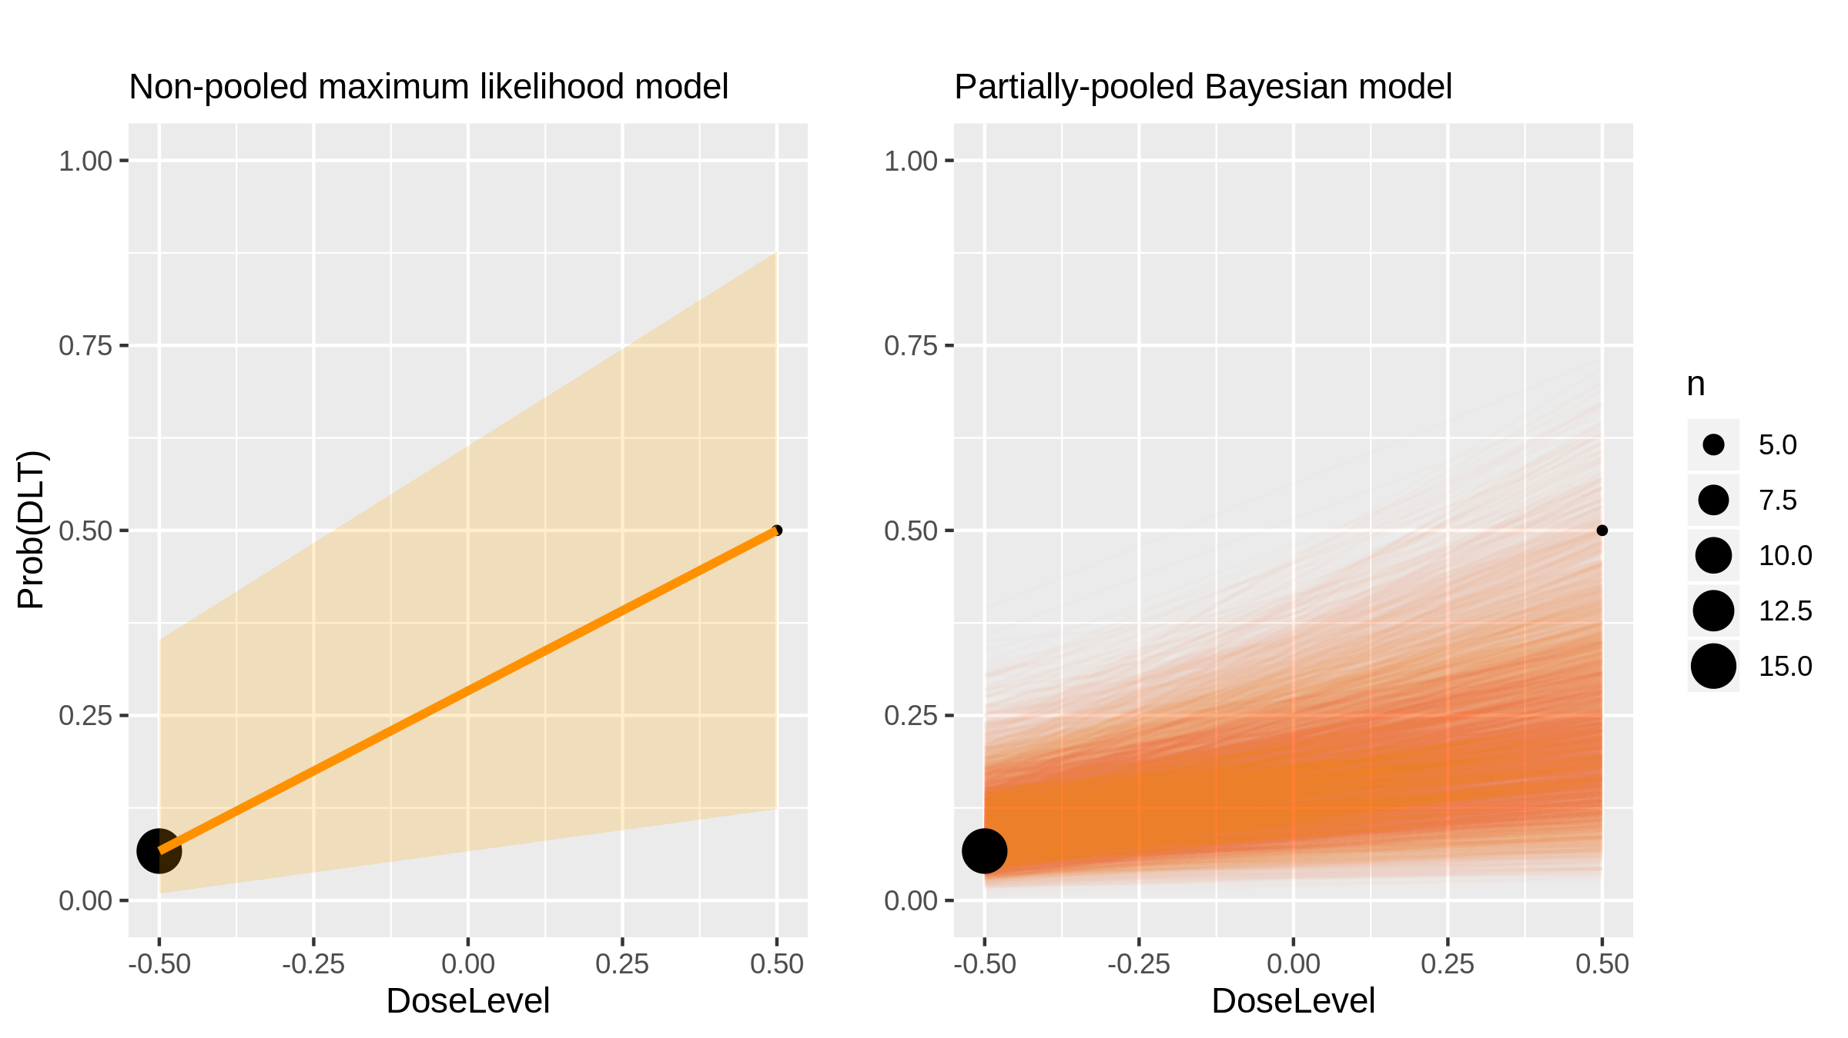
Dovitinib (Inhibitor) in Renal Cell Carcinoma [Angevin2013_1]

Slide 37
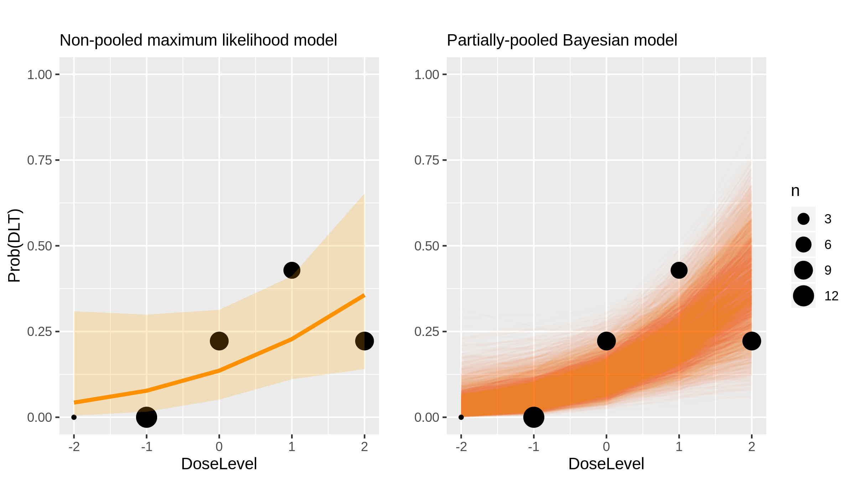
Radiation therapy (Radiotherapy) in Glioblastoma [Tsien2012_1]

Slide 38
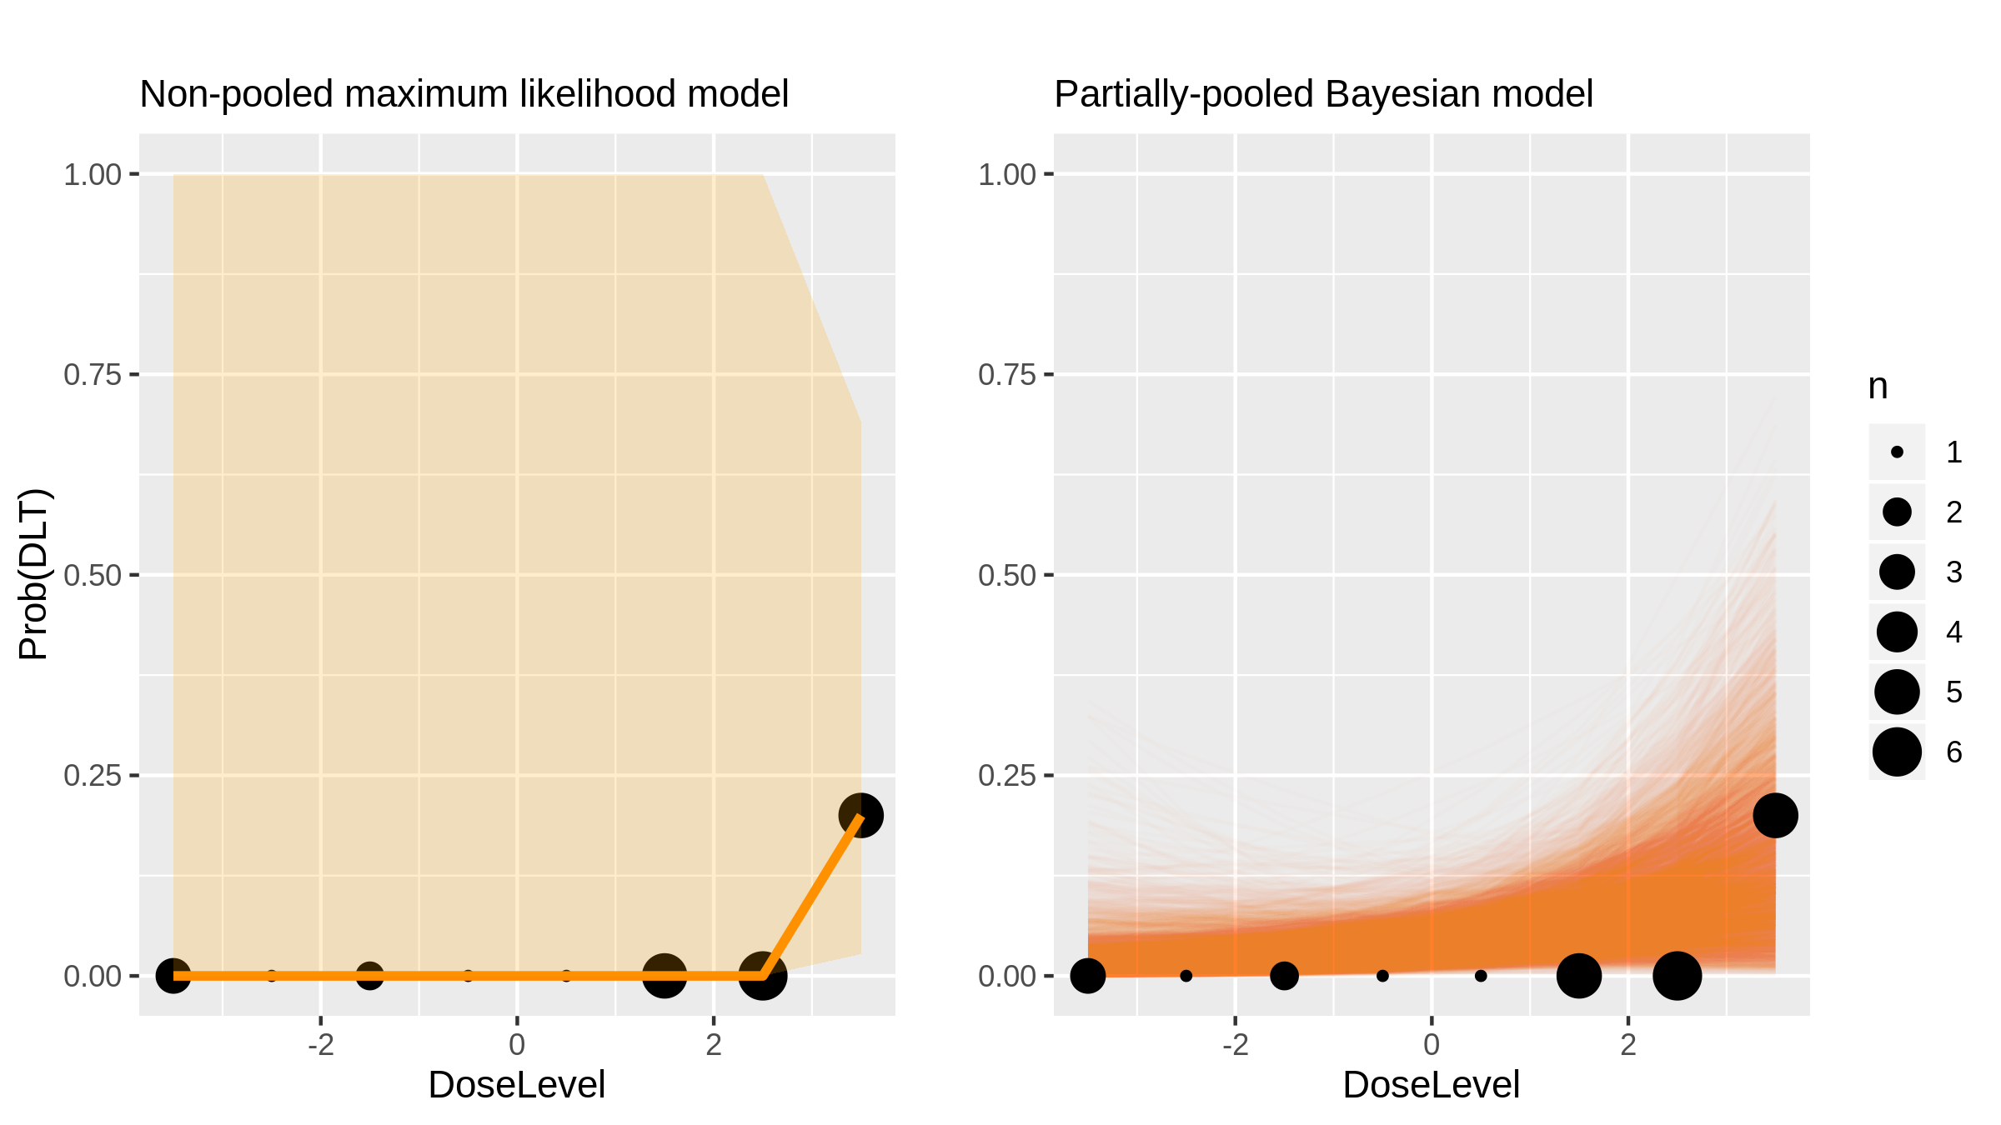
MKC-1 (Inhibitor) in Advanced Solid Tumours [Tevaarwek2012_1]

Slide 39
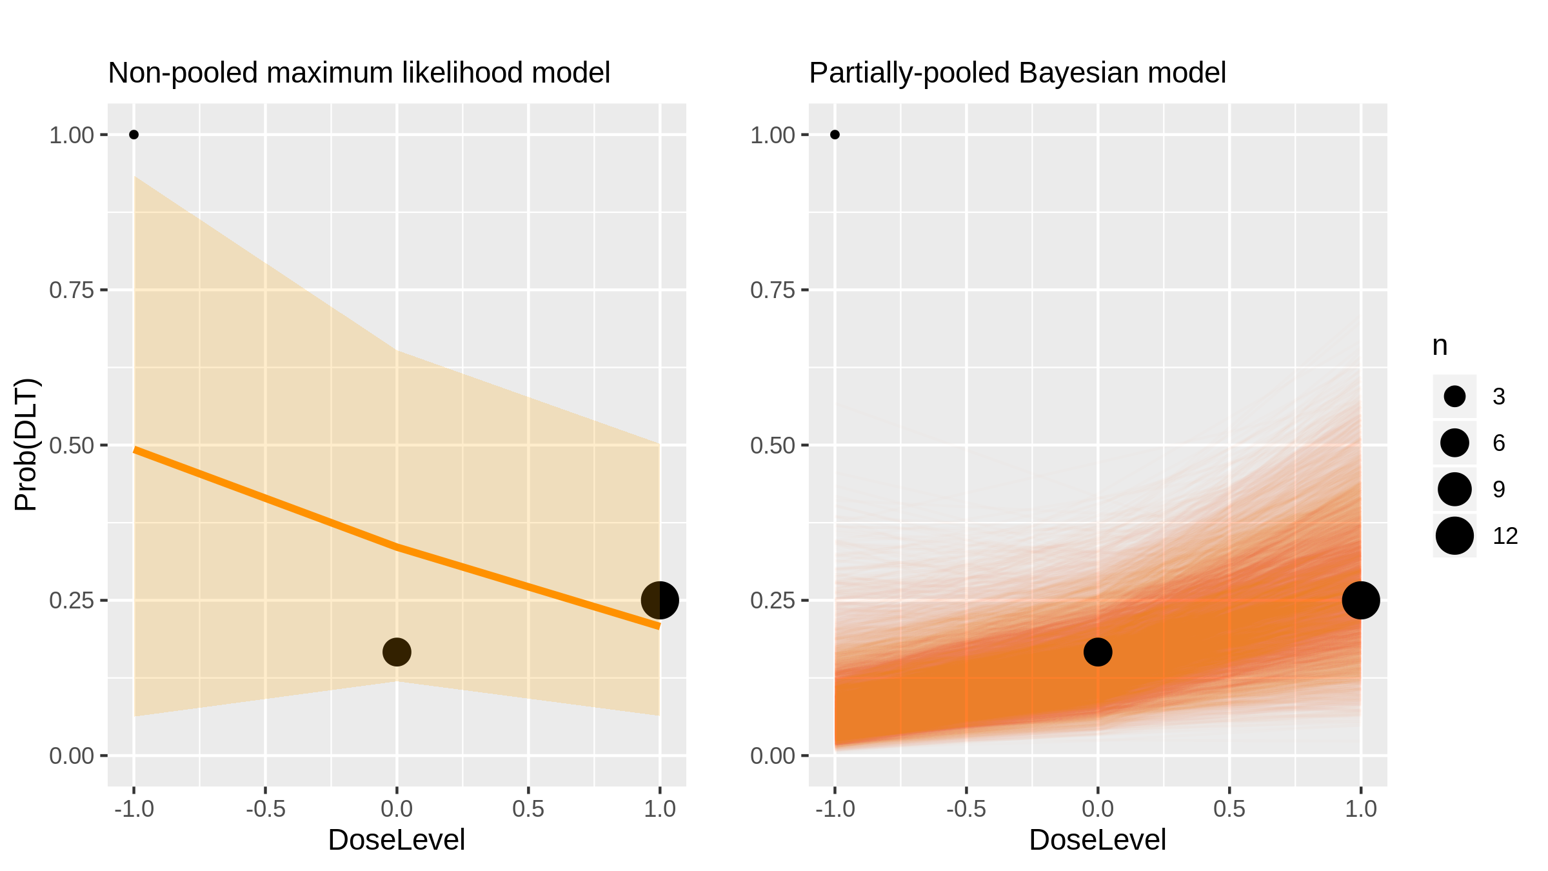
Bortezomib (Inhibitor) in Lymphoma [Sinha2012_1]

Slide 40
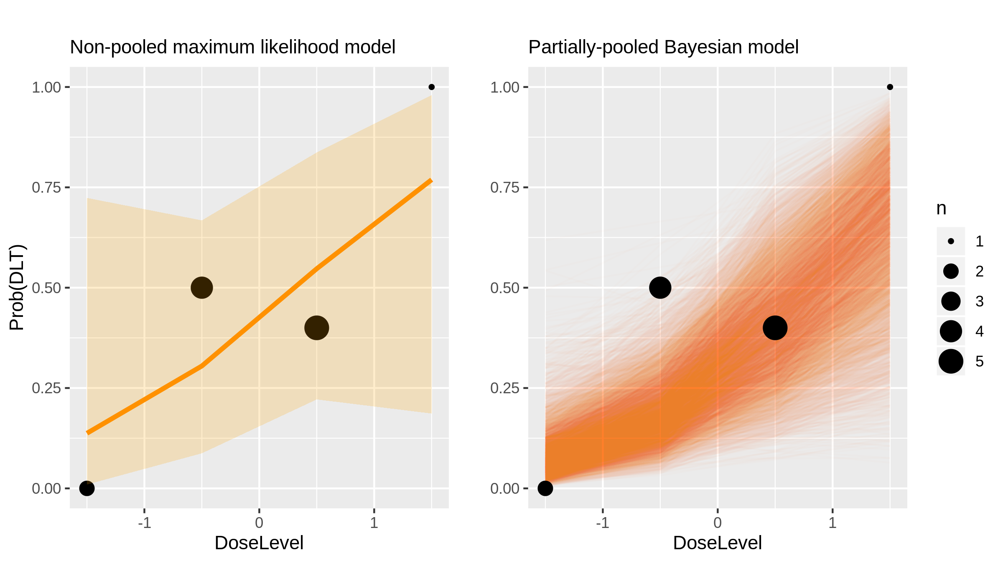
Vorinostat + docetaxel (Chemotherapy) in Advanced Solid Tumours [Schneider2012_1]

Slide 41
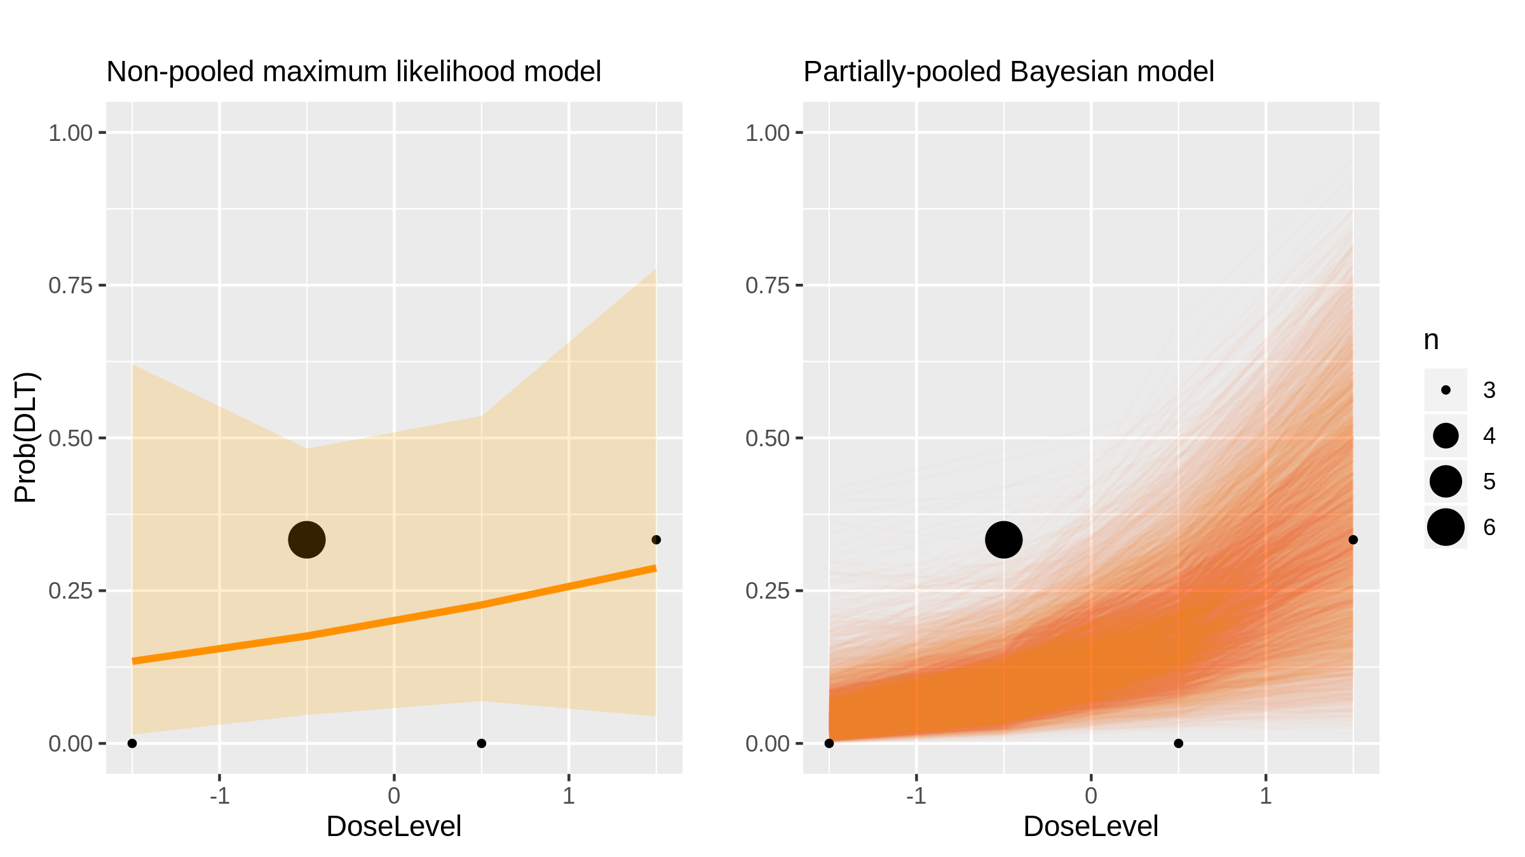
Navitoclax (Inhibitor) in Cll [Roberts2012_1]

Slide 42
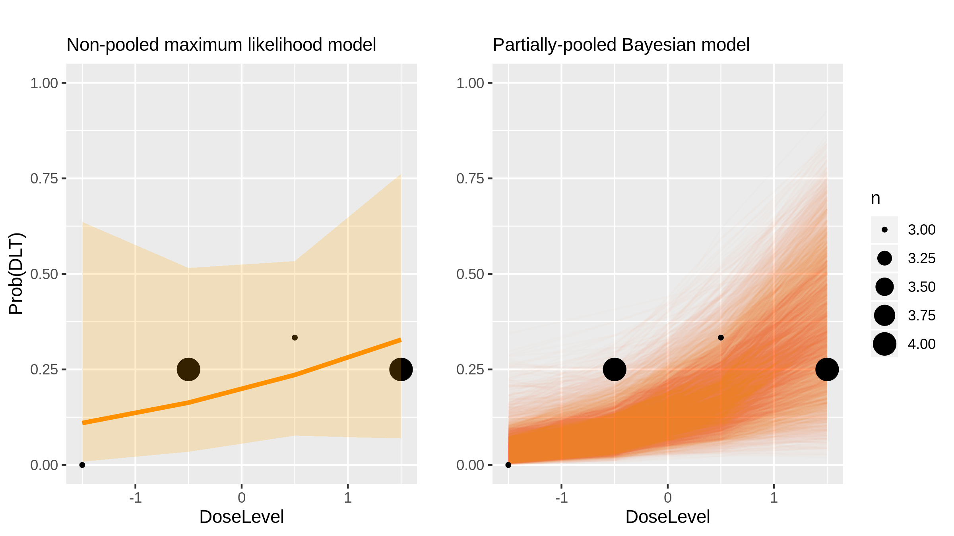
Navitoclax (Inhibitor) in Cll [Roberts2012_2]

Slide 43
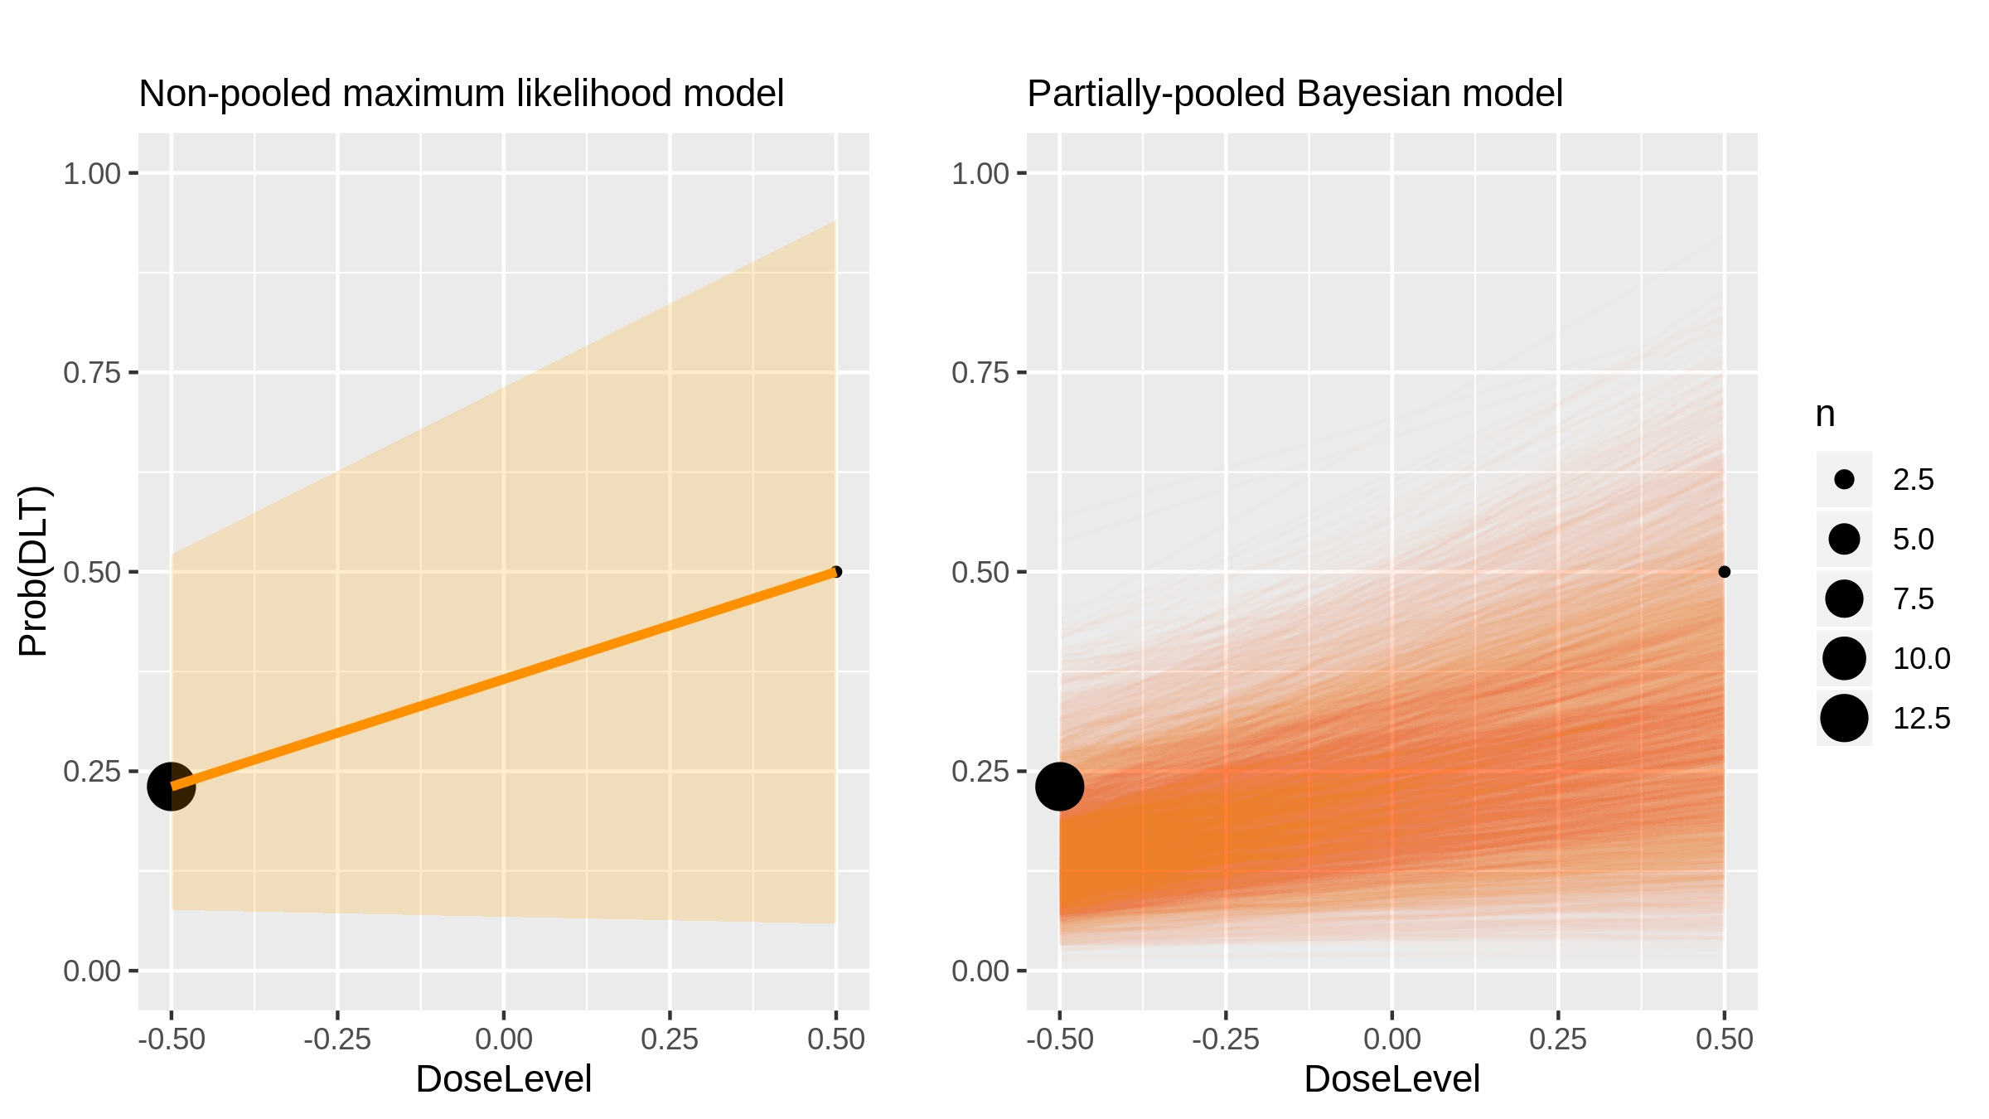
AEE788 (Inhibitor) in Glioblastoma [Reardon2012_1]

Slide 44
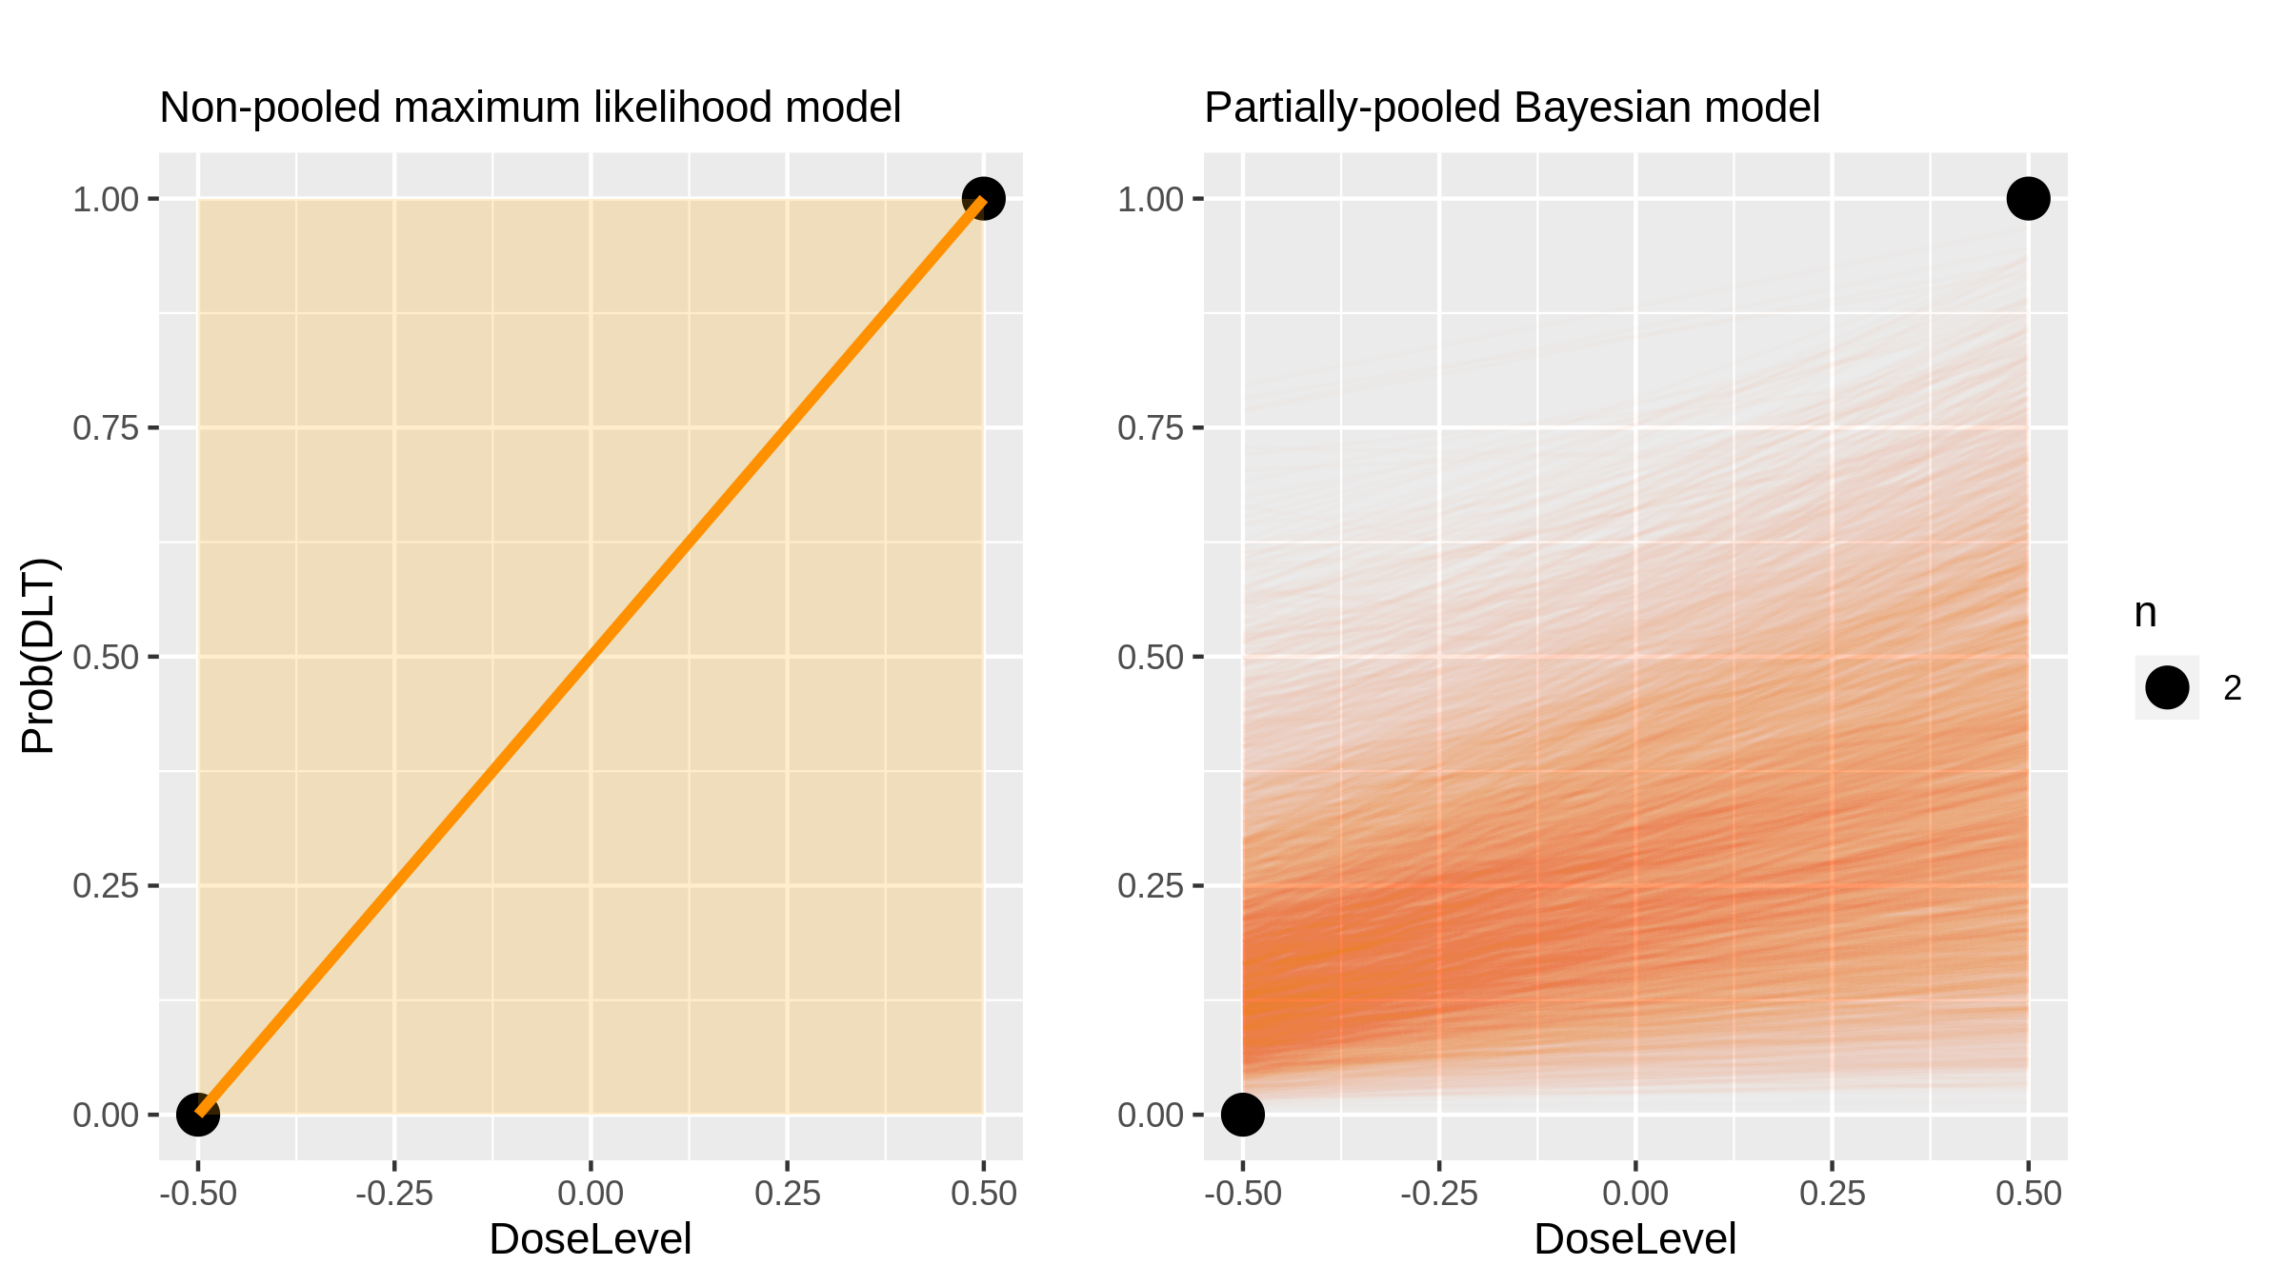
Everolimus + docetaxel (Chemotherapy + Inhibitor) in Breast Cancer [Moulder2012_1]

Slide 45
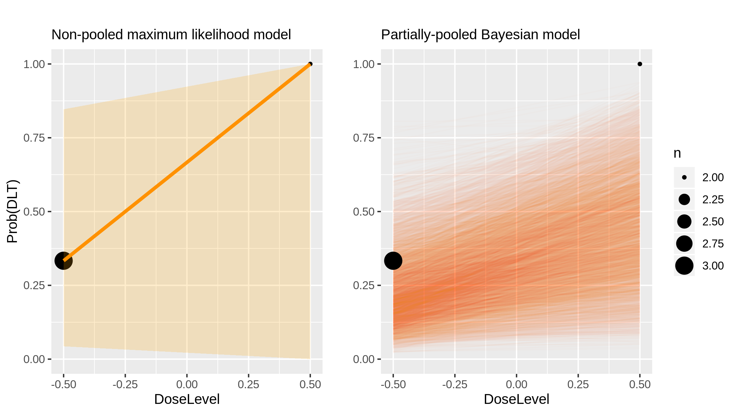
Everolimus + docetaxel (Chemotherapy + Inhibitor) in Breast Cancer [Moulder2012_1]

Slide 46
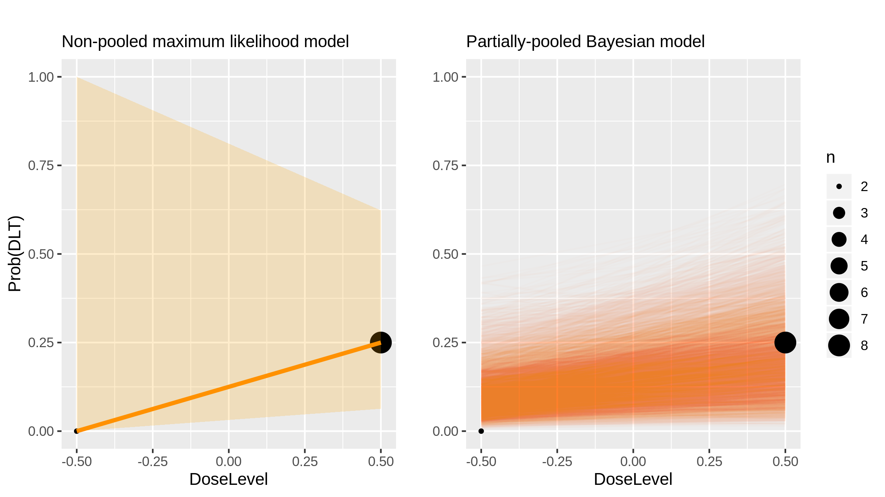
Everolimus + docetaxel (Chemotherapy + Inhibitor) in Breast Cancer [Moulder2012_1]

Slide 47
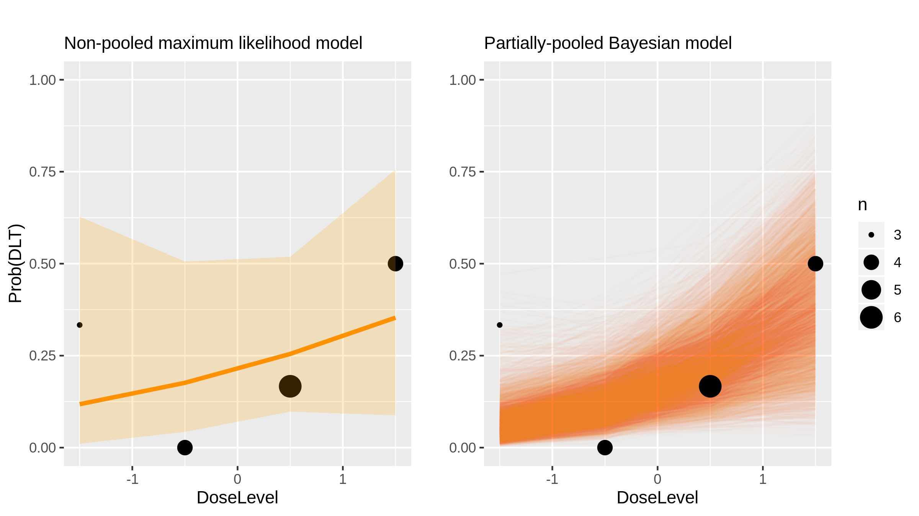
Capecitabine (Chemotherapy) in Advanced Solid Tumours [Mazard2012_1]

Slide 48
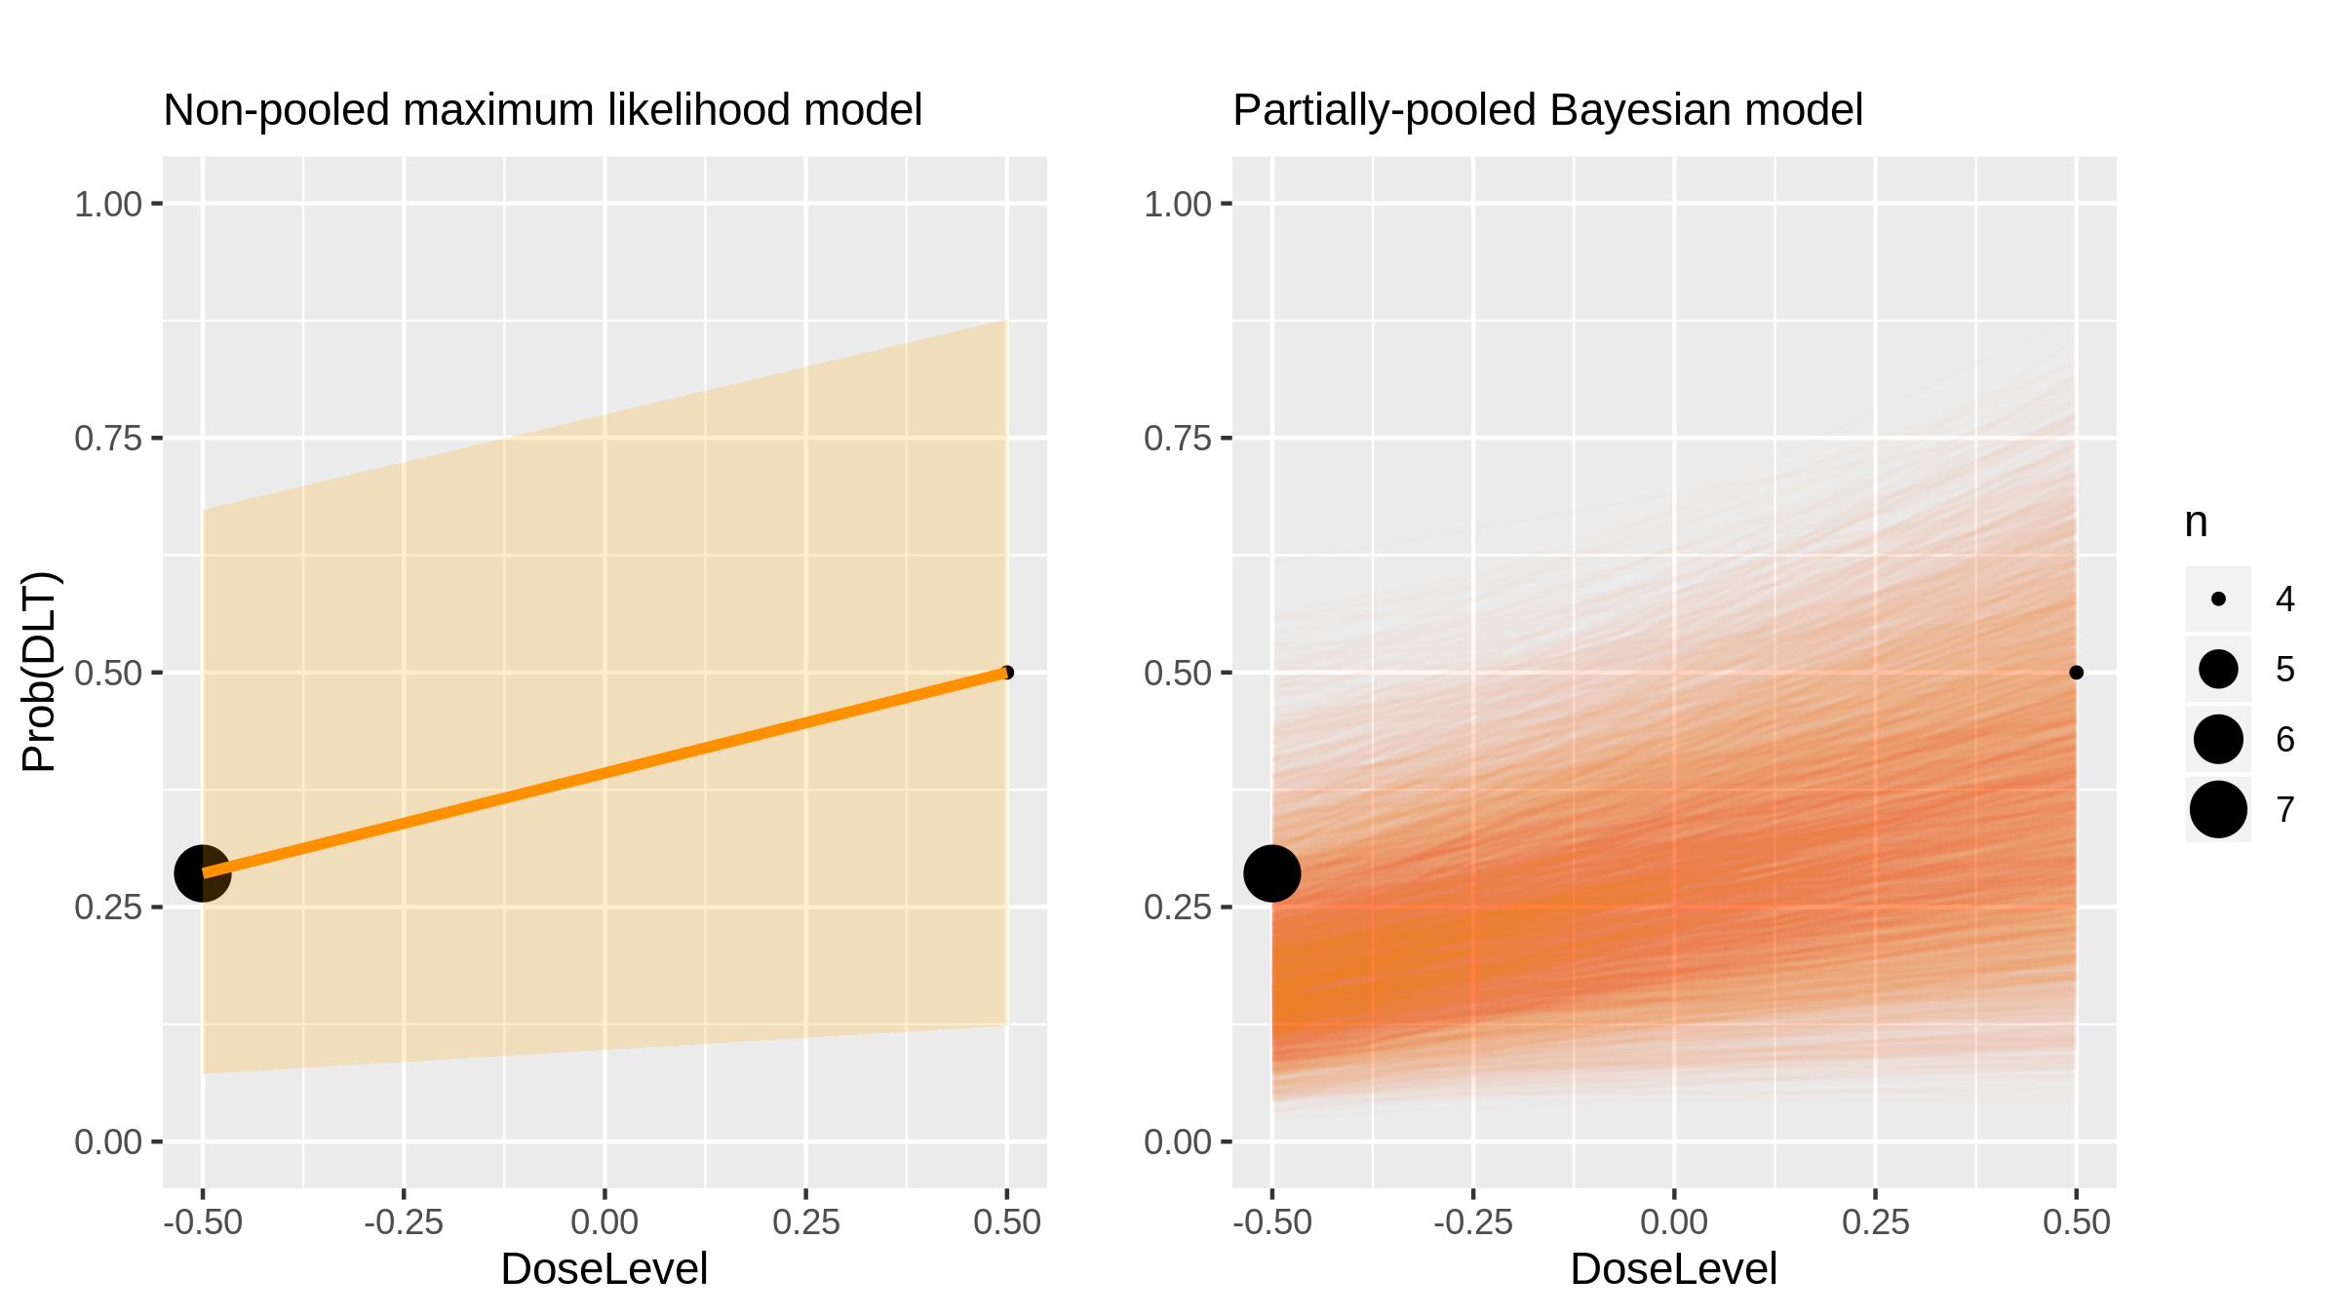
Capecitabine (Chemotherapy) in Advanced Solid Tumours [Mazard2012_2]

Slide 49
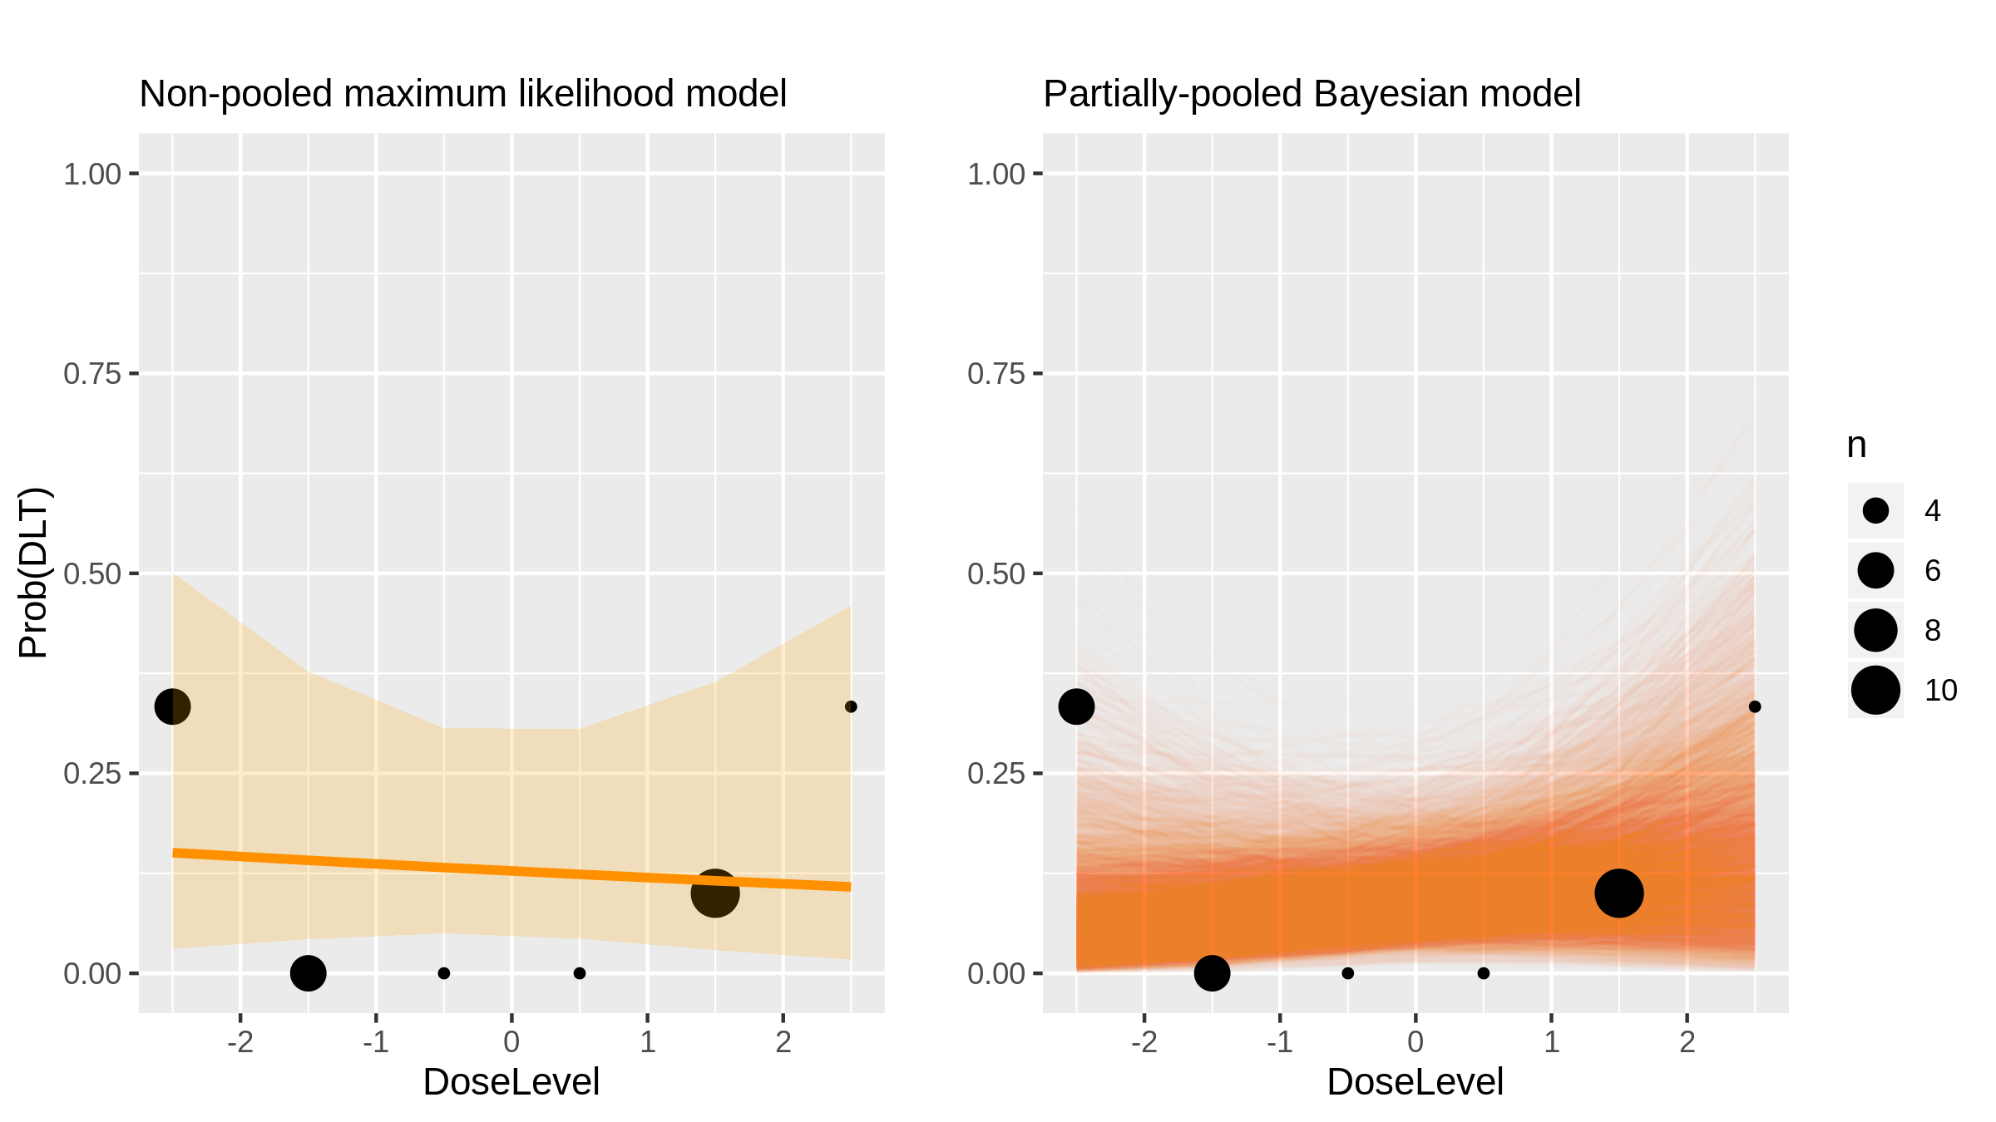
DOTAP:cholesterol(DC)-TUSC2 (GeneTherapy) in Nsclc [Lu2012_1]

Slide 50
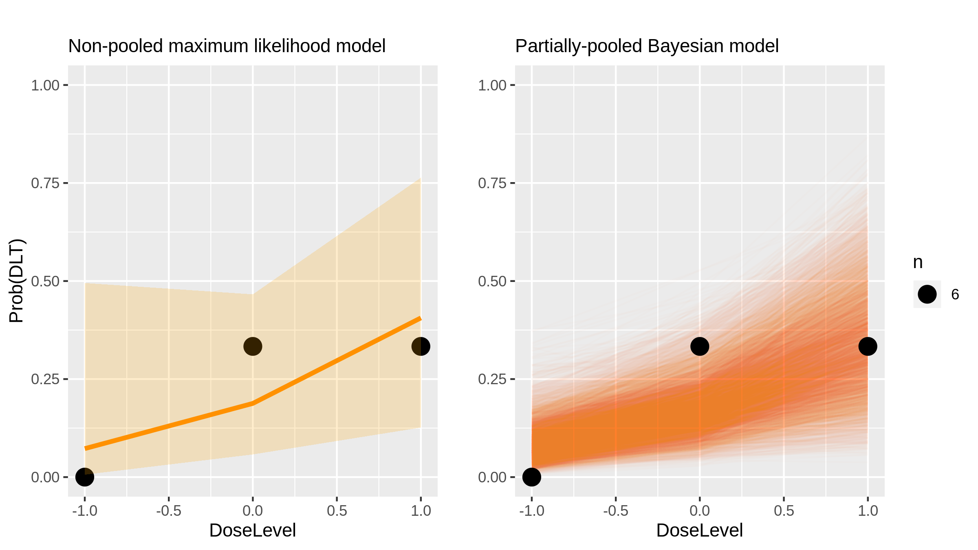
Amrubicin (Chemotherapy) in Sclc [Kawahara2012_1]

Slide 51
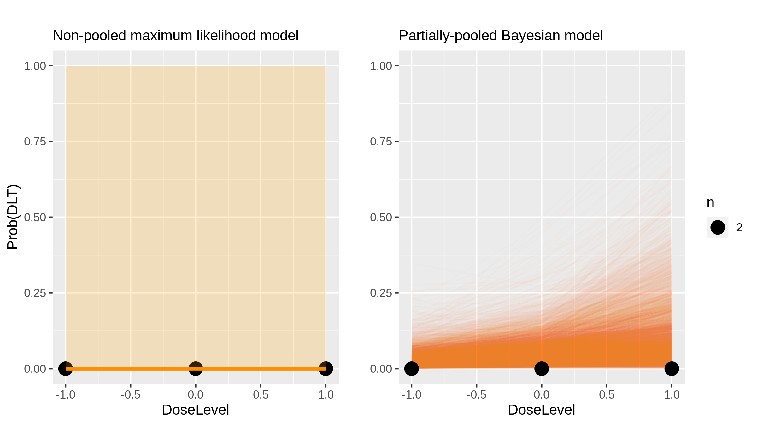
Bortezomib + vorinostat (Chemotherapy + inhibitor) in Nsclc [Jones2012_1]

Slide 52

Bortezomib + vorinostat (Chemotherapy + inhibitor) in Nsclc [Jones2012_1]

Slide 53

Bortezomib + vorinostat (Chemotherapy + inhibitor) in Nsclc [Jones2012_1]

Slide 54

Bortezomib + vorinostat (Chemotherapy + inhibitor) in Nsclc [Jones2012_1]

Slide 55

Carfilzomib (Inhibitor) in Multiple Myeloma [Jakubowiak2012_1]

Slide 56

Capecitabine (Chemotherapy) in Colorectal Cancer [Farid2012_1]

Slide 57

Polyphenon E (Chemoprevention) in Hormone Receptor-Negative Breast Cancer [Crew2012_1]

Slide 58

BKM120 (Inhibitor) in Advanced Solid Tumours [Bendell2012_1]

Slide 59

Intensity modulated radiation (Radiotherapy) in Pancreatic Cancer [Ben-Josef2012_1]

Slide 60

Lenalidomide (Immunomodulatory drug) in Cns Tumours [Warren2011_1]

Slide 61

Everolimus (Inhibitor) in Nsclc [Vansteenkist2011_1]

Slide 62

Everolimus (Inhibitor) in Nsclc [Vansteenkist2011_2]

Slide 63

Bryostatin-1 (Inhibitor) in Myeloid Malignancies [Smith2011_1]

Slide 64

Bryostatin-1 (Inhibitor) in Myeloid Malignancies [Smith2011_1]

Slide 65

Irinotecan (Chemotherapy) in Gastorintestinal Cancer [Satoh2011_1]

Slide 66

Irinotecan (Chemotherapy) in Gastorintestinal Cancer [Satoh2011_2]

Slide 67

Paclitaxel + bortezomib (Chemotherapy + inhibitor) in Advanced Solid Tumours [Mehnert2011_1]

Slide 68

Clofarabine (Chemotherapy) in Blood Cancers [Magenau2011_1]

Slide 69

Gemcitabine prodrug (LY2334737) (Chemotherapy) in Advanced Solid Tumours [Koolen2011_1]

Slide 70

Gemcitabine prodrug (LY2334737) (Chemotherapy) in Advanced Solid Tumours [Koolen2011_2]

Slide 71

Dovitinib (Inhibitor) in Melanoma [Kim2011_1]

Slide 72

Lenalidomide + pegylated liposomal docorubicin (Immunomodulatory drug + Chemotherapy) in Multiple Myeloma [Jakubowiak2011_1]

Slide 73

Erlotinib (Inhibitor) in Brain Cancers [Geoerger2011_1]

Slide 74

Erlotinib (Inhibitor) in Brain Cancers [Geoerger2011_2]

Slide 75

MK-0751 (Inhibitor) in Cns Tumours [Fouladi2011_1]

Slide 76

Ixabepilone (Chemotherapy) in Glioma [Peereboom2010_1]

Slide 77

Ixabepilone (Chemotherapy) in Glioma [Peereboom2010_2]

Slide 78

Bortezomib (Inhibitor) in Lymphoma [Furman2010_1]

Slide 79

Lapatinib (Inhibitor) in Cns Tumours [Fouladi2010_1]

Slide 80

Lapatinib (Inhibitor) in Cns Tumours [Fouladi2010_2]

Slide 81

¹⁵³Sm-EDTMP (Radiotherapy) in Osteosarcoma [Loeb2009_1]

Slide 82

H103 (Cell therapy) in Advanced Solid Tumours [Li2009_1]

Slide 83

Nilotinib + Imatinib (Inhibitor) in Gastrointestinal Cancer [Demetri2009_1]

Slide 84

Nilotinib + Imatinib (Inhibitor) in Gastrointestinal Cancer [Demetri2009_1]

Slide 85

Nilotinib + Imatinib (Inhibitor) in Gastrointestinal Cancer [Demetri2009_1]

Slide 86

Naptumomab estafenatox (Monoclonal Antibody) in Advanced Solid Tumours [Borghaei2009_1]

Slide 87

Naptumomab estafenatox (Monoclonal Antibody) in Nsclc [Borghaei2009_2]

Slide 88

Nilotinib + Imatinib (Inhibitor) in Gastrointestinal Cancer [Bailey2009_1]

Slide 89

Nilotinib + Imatinib (Inhibitor) in Gastrointestinal Cancer [Bailey2009_1]

Slide 90

Epirubicin + capecitabine (Chemotherapy) in Breast Cancer [Saji2008_1]

Slide 91

Cilengitide (Inhibitor) in Brain Cancers [MacDonald2008_1]

Slide 92

Rapamycin (Inhibitor) in Solid Tumours [Jimeno2008_1]

Slide 93

Cloretazine (Chemotherapy) in Brain Cancers [Gururangan2008_1]

Slide 94

Cloretazine (Chemotherapy) in Brain Cancers [Gururangan2008_2]

Slide 95

Temozolomide (Chemotherapy) in Melenoma [Guillot2008_1]

Slide 96

Temozolomide (Chemotherapy) in Melenoma [Guillot2008_1]

Slide 97

Karenitecin (Chemotherapy) in Glioma [Grossman2008_1]

Slide 98

Karenitecin (Chemotherapy) in Glioma [Grossman2008_2]

Slide 99

LAQ824 (Chemotherapy) in Advanced Solid Tumours [DeBono2008_1]

Slide 100

Hypofractionated radiotherapy (Radiotherapy) in Nsclc [Adkison2008_1]

Slide 101

Busulfan (Chemotherapy) in Blood Cancers [O’Donnell2010_1]

Slide 102

Everolimus (Inhibitor) in Breast Cancer [Andre2010_1]

Slide 103

Not disclosed (NotDisclosed) in Not Disclosed [Neuenschwander2008_1]

Slide 104

BGT226 (Inhibitor) in Advanced Solid Tumours [Markman2012_1]

Slide 105

Gemcitabine (Chemotherapy) in Biliary Tract Cancer [Kobayashi2014_1]

Slide 106

Gemcitabine (Chemotherapy) in Biliary Tract Cancer [Kobayashi2014_1]

Slide 107

S-1 (Chemotherapy) in Biliary Tract Cancer [Kobayashi2014_2]

Slide 108

Bosutinib (Inhibitor) in Advanced Solid Tumours [Isakoff2014_1]

Slide 109

Bosutinib (Inhibitor) in Advanced Solid Tumours [Isakoff2014_1]

Slide 110

Bosutinib (Inhibitor) in Advanced Solid Tumours [Isakoff2014_1]

Slide 111

Neratinib (Inhibitor) in Solid Tumours [Gandhi2014_1]

Slide 112

Neratinib (Inhibitor) in Solid Tumours [Gandhi2014_1]

Slide 113

Neratinib (Inhibitor) in Solid Tumours [Gandhi2014_1]

Slide 114

Neratinib (Inhibitor) in Solid Tumours [Gandhi2014_1]

Slide 115

Capecitabine + erlotinib (Chemotherapy + Inhibitor) in Rectal Cancer [Das2014_1]

Slide 116

Clofarabine (Chemotherapy) in Aml [Foster2012_1]

Slide 117

Everolimus (Inhibitor) in Breast Cancer [Jerusalem2011_1]

Slide 118

Dalotuzumab (Monoclonal Antibody) in Advanced Solid Tumours [Atzori2011_1]

Slide 119

Dalotuzumab (Monoclonal Antibody) in Advanced Solid Tumours [Atzori2011_1]

Slide 120

Samarium 153 + Bortezomib (Radiopharmaceutical + Inhibitor) in Multiple Myeloma [Berensen2009_1]

Slide 121

Samarium 153 + Bortezomib (Radiopharmaceutical + Inhibitor) in Multiple Myeloma [Berensen2009_1]

Slide 122

Oxaliplatin + Flurouracil (Chemotherapy) in Oesophageal Cancer [Conroy2008_1]

Slide 123

Docetaxel + cisplatin (Chemotherapy) in Oesophageal Cancer [Day2011_1]

Slide 124

Chidamide (Chemotherapy) in Advanced Solid Tumours [Dong2012_1]

Slide 125

Chidamide (Chemotherapy) in Advanced Solid Tumours [Dong2012_1]

Slide 126

Reovirus (Oncolytic virus) in Glioma [Forsyth2008_1]

Slide 127

BI2356 (Inhibitor) in Advanced Solid Tumours [Frost2012_1]

Slide 128

Vorinostat (Chemotherapy) in Aml [Gojo2013_1]

Slide 129

AZD4877 (Inhibitor) in Aml [Kantarjian2012_1]

Slide 130

Docetaxel (Chemotherapy) in Melanoma [Kim2009_1]

Slide 131

Ad5-Δ24-RGD (Oncolytic virus) in Gynaecological Cancer [Kimball2010_1]

Slide 132

Ixabepilone (Chemotherapy) in Advanced Solid Tumours [Kunz2012_1]

Slide 133

Sunitinib, capecitabine, cisplatin (Chemotherapy + inhibitor) in Gastric Cancer [Lee2013_1]

Slide 134

Sunitinib, capecitabine, cisplatin (Chemotherapy + inhibitor) in Gastric Cancer [Lee2013_1]

Slide 135

Sunitinib, capecitabine, cisplatin (Chemotherapy + inhibitor) in Gastric Cancer [Lee2013_1]

Slide 136

TAK-285 (Inhibitor) in Advanced Solid Tumours [LoRusso2014_1]

Slide 137

TAK-285 (Inhibitor) in Advanced Solid Tumours [LoRusso2014_1]

Slide 138

Flavopiridol + doxorubicin (Chemotherapy + inhibitor) in Sarcoma [Luke2012_1]

Slide 139

Flavopiridol + doxorubicin (Chemotherapy + inhibitor) in Sarcoma [Luke2012_1]

Slide 140

Gemcitabine + sunitinib (Chemotherapy + inhibitor) in Advanced Solid Tumours [Michaelson2013_1]

Slide 141

Gemcitabine + sunitinib (Chemotherapy + inhibitor) in Advanced Solid Tumours [Michaelson2013_1]

Slide 142

E7820 (Inhibitor) in Advanced Solid Tumours [Mita2011_1]

Slide 143

Panobinostat and Everolimus (Chemotherapy + inhibitor) in Lymphoma [Oki2013_1]

Slide 144

Lenalidomide (Immunomodulatory drug) in Aml [Pollyea2012_1]

Slide 145

Cytarabine (Chemotherapy) in Aml [Rao2012_1]

Slide 146

Thalidomide/docetaxel (Immunomodulatory drug + chemotherapy) in Advanced Solid Tumours [Sanborn2008_1]

Slide 147

Thalidomide/docetaxel (Immunomodulatory drug + chemotherapy) in Advanced Solid Tumours [Sanborn2008_1]

Slide 148

Foretinib (Inhibitor) in Advanced Solid Tumours [Shapiro2013_1]

Slide 149

Clofarabine (Chemotherapy) in Lymphoma [Srivastava2011_1]

Slide 150

Darinaparsin (Chemotherapy) in Advanced Solid Tumours [Tsimberidou2009_1]

Slide 151

Nedaplatin (Chemotherapy) in Cervical Cancer [Yamamoto2009_1]

Slide 152

Brentuximab Vedotin (Monoclonal Antibody) in Lymphoma [Younes2010_1]

Slide 153

GM-CSF + IL-2 + IFN-α (Cytokine) in Rcc [Garcia2012_1]

Slide 154

Etoposide (Chemotherapy) in Aml [Saraiya2008_1]

Slide 155

Temsirolimus (Inhibitor) in Advanced Solid Tumours [Spunt2011_1]

Slide 156

Cisplatin (Chemotherapy) in Head & Neck Scc [Yu2010_1]

